Slide 1
Common Resources
Steven Suranovic
George Washington University

Slide 2
Common Resources
Resources in common usage are non-excludable and rival in consumption
Examples include,
Open Pastures
Ocean fisheries
River irrigation systems
Because caught fish is rival and the difficulty of monitoring who fishes makes it non-excludable

Slide 3
A Common Resource Problem
Suppose a town has two occupations: rancher and farmer and 20 people working
Suppose farmland is plentiful but good pastureland is scarce
Suppose farming provides $10 of income per day
Let Ranching provide income per rancher according to the following schedule: I = 50 – 5n , where n is the number of people in ranching

Slide 4
A Common Resource Problem
Income schedule per person
n | Rancher I = 50 – 5n | Opp. Cost Farmer income
1 | 45 | 10
2 | 40 | 10
3 | 35 | 10
4 | 30 | 10
5 | 25 | 10
6 | 20 | 10
7 | 15 | 10
8 | 10 | 10
9 | 5 | 10
Private outcome: 8 people will go into ranching since that will set the private benefit (10) equal to the opportunity cost (10)

Slide 5
A Common Resource Problem
Optimal Outcome - Find where Total Town income is maximized (@280)
4 people go into ranching
Ranchers are wealthier than farmers
But, profit seeking will inspire entry of new ranchers, thus cannot sustain the most efficient outcome
Town Total Income schedule
n | RI = 50 – 5n (per person) | RI * n (Total RI) | FI*(20-n)= Total FI | Total (Total RI + FI)
1 | 45 | 45 | 190 | 235
2 | 40 | 80 | 180 | 260
3 | 35 | 105 | 170 | 275
4 | 30 | 120 | 160 | 280
5 | 25 | 125 | 150 | 275
6 | 20 | 120 | 140 | 260
7 | 15 | 105 | 130 | 235
8 | 10 | 80 | 120 | 200
9 | 5 | 45 | 110 | 155

Slide 6
A Common Resource Problem
Suppose red marks unsustainable ranching
n | RI = 50 – 5n (per person) | RI * n (Total RI) | FI*(20-n)= Total FI | Total (Total RI + FI)
1 | 45 | 45 | 190 | 235
2 | 40 | 80 | 180 | 260
3 | 35 | 105 | 170 | 275
4 | 30 | 120 | 160 | 280
5 | 25 | 125 | 150 | 275
6 | 20 | 120 | 140 | 260
7 | 15 | 105 | 130 | 235
8 | 10 | 80 | 120 | 200
9 | 5 | 45 | 110 | 155
In this case the private outcome of 8 ranchers results in a
Tragedy of the Commons
as the pastureland will be depleted and cease producing

Slide 7
A Common Resource Problem
The Case of Government Intervention
Tax ranchers $20 each
Ranchers fall to 4
Tax revenue is $80
Total income rises by $80
Could also regulate with fishing quotas
n | RI = 50 – 5n (per person) | RI * n (Total RI) | FI*(20-n)= Total FI | Total (Total RI + FI)
1 | 45 | 45 | 190 | 235
2 | 40 | 80 | 180 | 260
3 | 35 | 105 | 170 | 275
4 | 30 | 120 | 160 | 280
5 | 25 | 125 | 150 | 275
6 | 20 | 120 | 140 | 260
7 | 15 | 105 | 130 | 235
8 | 10 | 80 | 120 | 200
9 | 5 | 45 | 110 | 155

Slide 8
Common Resource Lessons
Private profit incentives will induce over usage of the common resource and potentially cause a tragedy of the commons result
The tragedy is that the resource (pasture) is so much depleted that it does not sustain the herds of cattle
Government can correct the problem with an appropriate taxation scheme
A non-government solution is possible too with collective private action

Slide 9
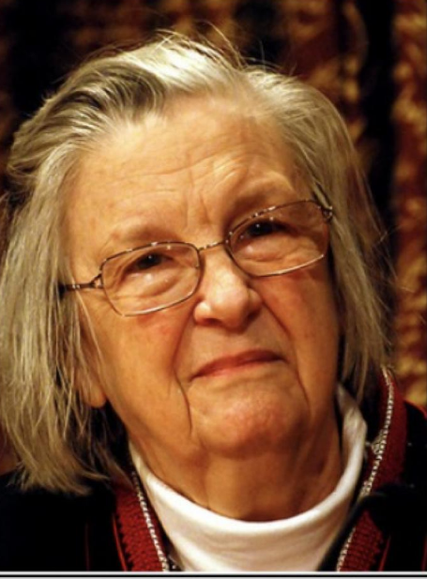
Elinor Ostrom (1933 -2012)
Economics Nobel 2009 (1st woman)
Her work showed many examples of how communities solved common resource problems on their own (without government)
Tobel, Switzerland common alpine grazing land is shared, with rules dating to 1483
Irrigation systems in Nepal .. etc. etc.
Tragedy of the Commons is a Prisoner’s Dilemma problem
Solution is possible with force (government)
Solution is possible with community cooperation (Ostrom)

Slide 10
Collective Private Action
Collective action in this case involves community rules or norms that limit fishing excursions, allocates fishing rights fairly, and monitors and enforces the rules
From Olson we know that this is more likely when the group is smaller since free riding can be reduced or eliminated
In this case, free riding involves someone willing to break the rules to catch more fish

Slide 11
Problems with Government
Knowing the optimal tax requires knowing the schedule of income possibilities, the amount of the common resource, resource depletion rates, the tipping point for sustainability, etc. (not simple to collect or estimate this data)
Local fishers know these things better (although imperfectly)
A government tax set at the wrong level could make things worse

Slide 12
