Slide 1
Ethics of Market Competition
Steven Suranovic
George Washington University

Slide 2
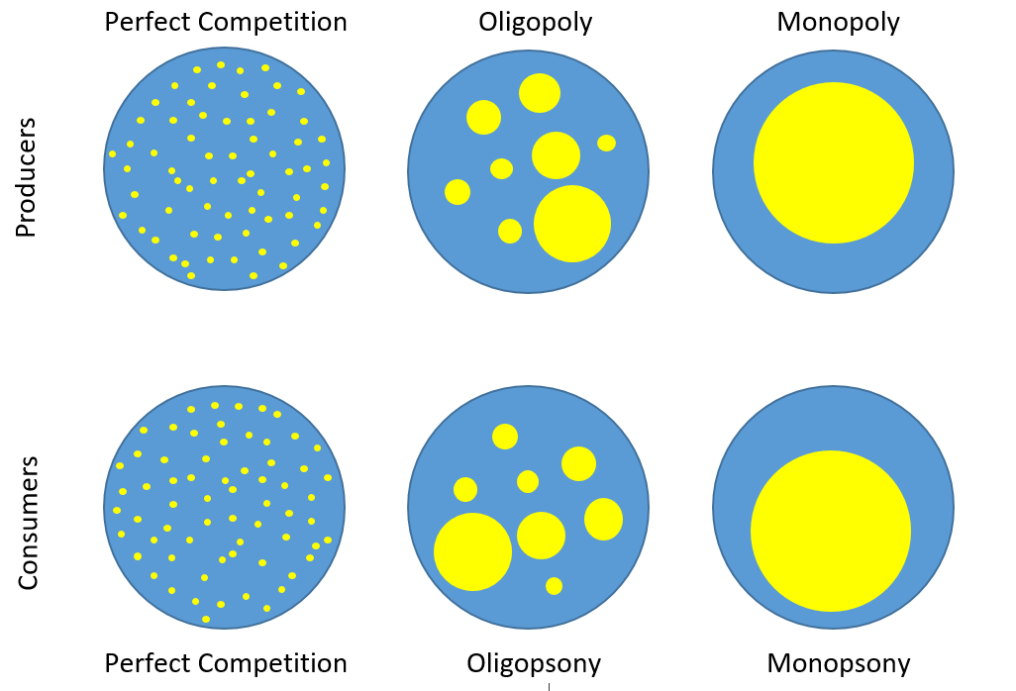
Market Structures

Slide 3
WELFARE EFFECTS OF RISING SUPPLY COMPETITION (i.e., more firms)
INCUMBENT FIRM PROFIT | ↓
NEW ENTRANT FIRM PROFIT | ↑
CONSUMER SURPLUS | ↑
OVERALL MARKET WELFARE | ↑

Slide 4
WELFARE EFFECTS OF COMPETITION RESTRICTIONS
a.k.a. Monopolizing or gaining monopoly power
Price will tend to rise; output will fall
Economic Efficiency is reduced
Firms may not produce at minimum cost
Consumers cannot buy as much due to higher prices
Firms make extra “rents” (or profit) while harming others
FREEDOM to enter the market and compete is reduced

Slide 5
WELFARE EFFECTS OF COMPETITION RESTRICTIONS
INCUMBENT FIRM PROFIT | ↑
CONSUMER SURPLUS | ↓
OVERALL MARKET WELFARE | ↓

Slide 6
FIRM REACTIONS TO COMPETITION

Slide 7
PRODUCT DIFFERENTIATION
Distinguish the good characteristics
unique color, design, function, shape, materials, etc. (eg. styles of brooms)
Distinguish the Quality
Longer-lasting, more resilient, etc.
simpler, less reliable, etc. (watches)
Enhance Service
Warranties, help lines, delivery options, repairs, etc.
Acceptable practice because it expands varieties and quality which improves consumer welfare

Slide 8
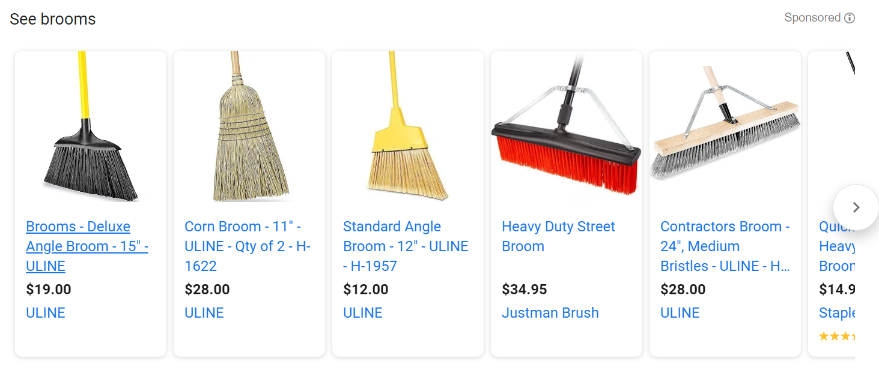

Slide 9
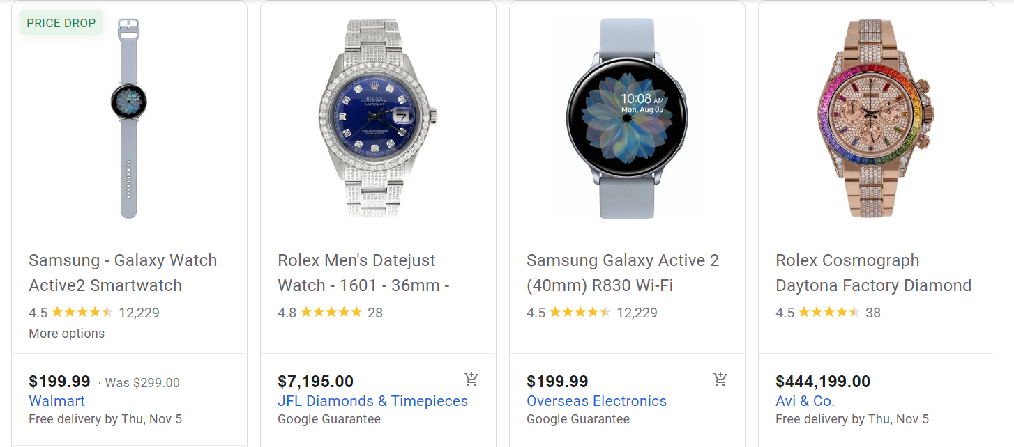

Slide 10
PROCESS INNOVATION
Reduce Production costs with ….
New machinery/equipment
New inventory procedures (e.g. just-in-time)
Release unproductive workforce
If possible,
Keep innovations secret
Patent new inventions
Acceptable practice because it lowers prices for consumers

Slide 11
ESTABLISH INTELLECTUAL PROPERTY RIGHTS
Create a Brand and Trademark
Logos https://www.digitalconnectmag.com/wp-content/uploads/2016/08/Five-Valuable-Interesting-And-Bizarre-Uses-Of-Trade-Marks.jpg
Sound Trademarks: http://mentalfloss.com/article/65162/18-sounds-you-probably-didnt-realize-were-trademarked
Acceptable practice because it provides more perfect info for consumers.

Slide 12
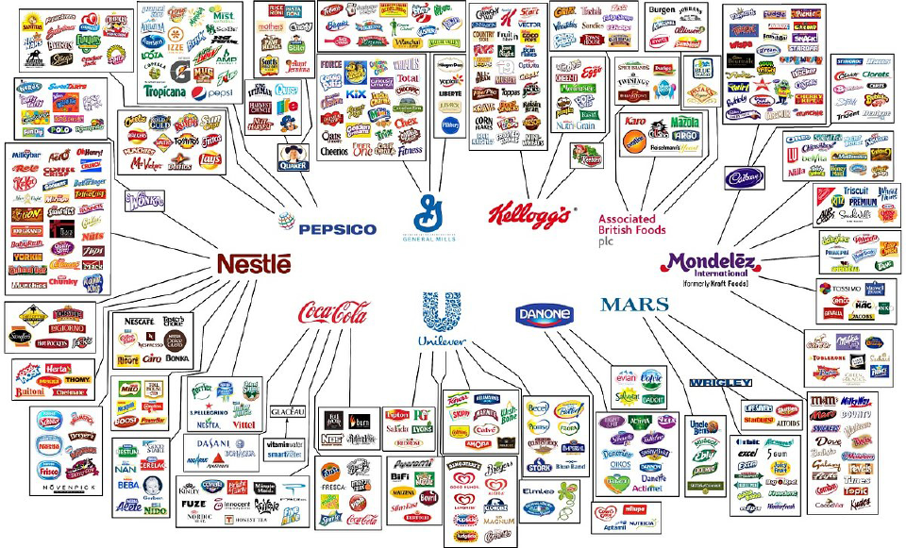

Slide 13
ESTABLISH INTELLECTUAL PROPERTY RIGHTS (IPR)
Patents
20 year monopoly right (keeps prices high)
Higher profit intended to spur innovation
Affects product diffusion
Note Radio vs Telephone
Could also slow innovation though
Copyrights
Books ; Music ; Movies
70 years after authors death
Positive: Weak IPR protections may spur innovation
Negative: Strong IPR protections may inhibit innovation and create excessive economic rents

Slide 14
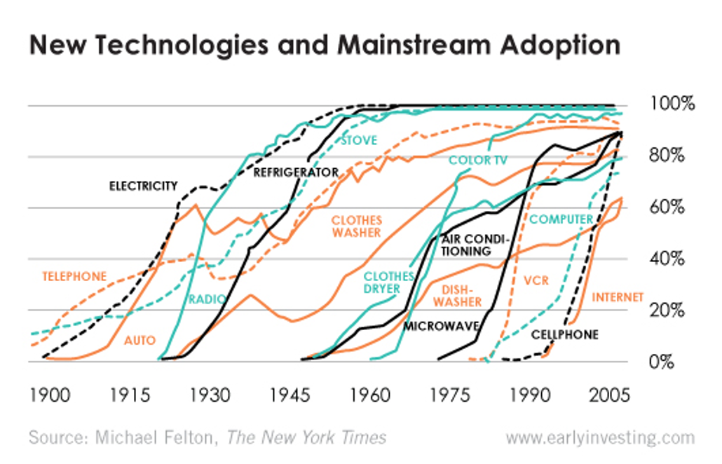

Slide 15
ADVERTISE YOUR BRAND
Pros
Gives consumers product information
Enables reputations to develop
Cons
Induces people to buy what they don’t want or need
may involve deception
Trivago commercial – Anything deceptive here?

Slide 18
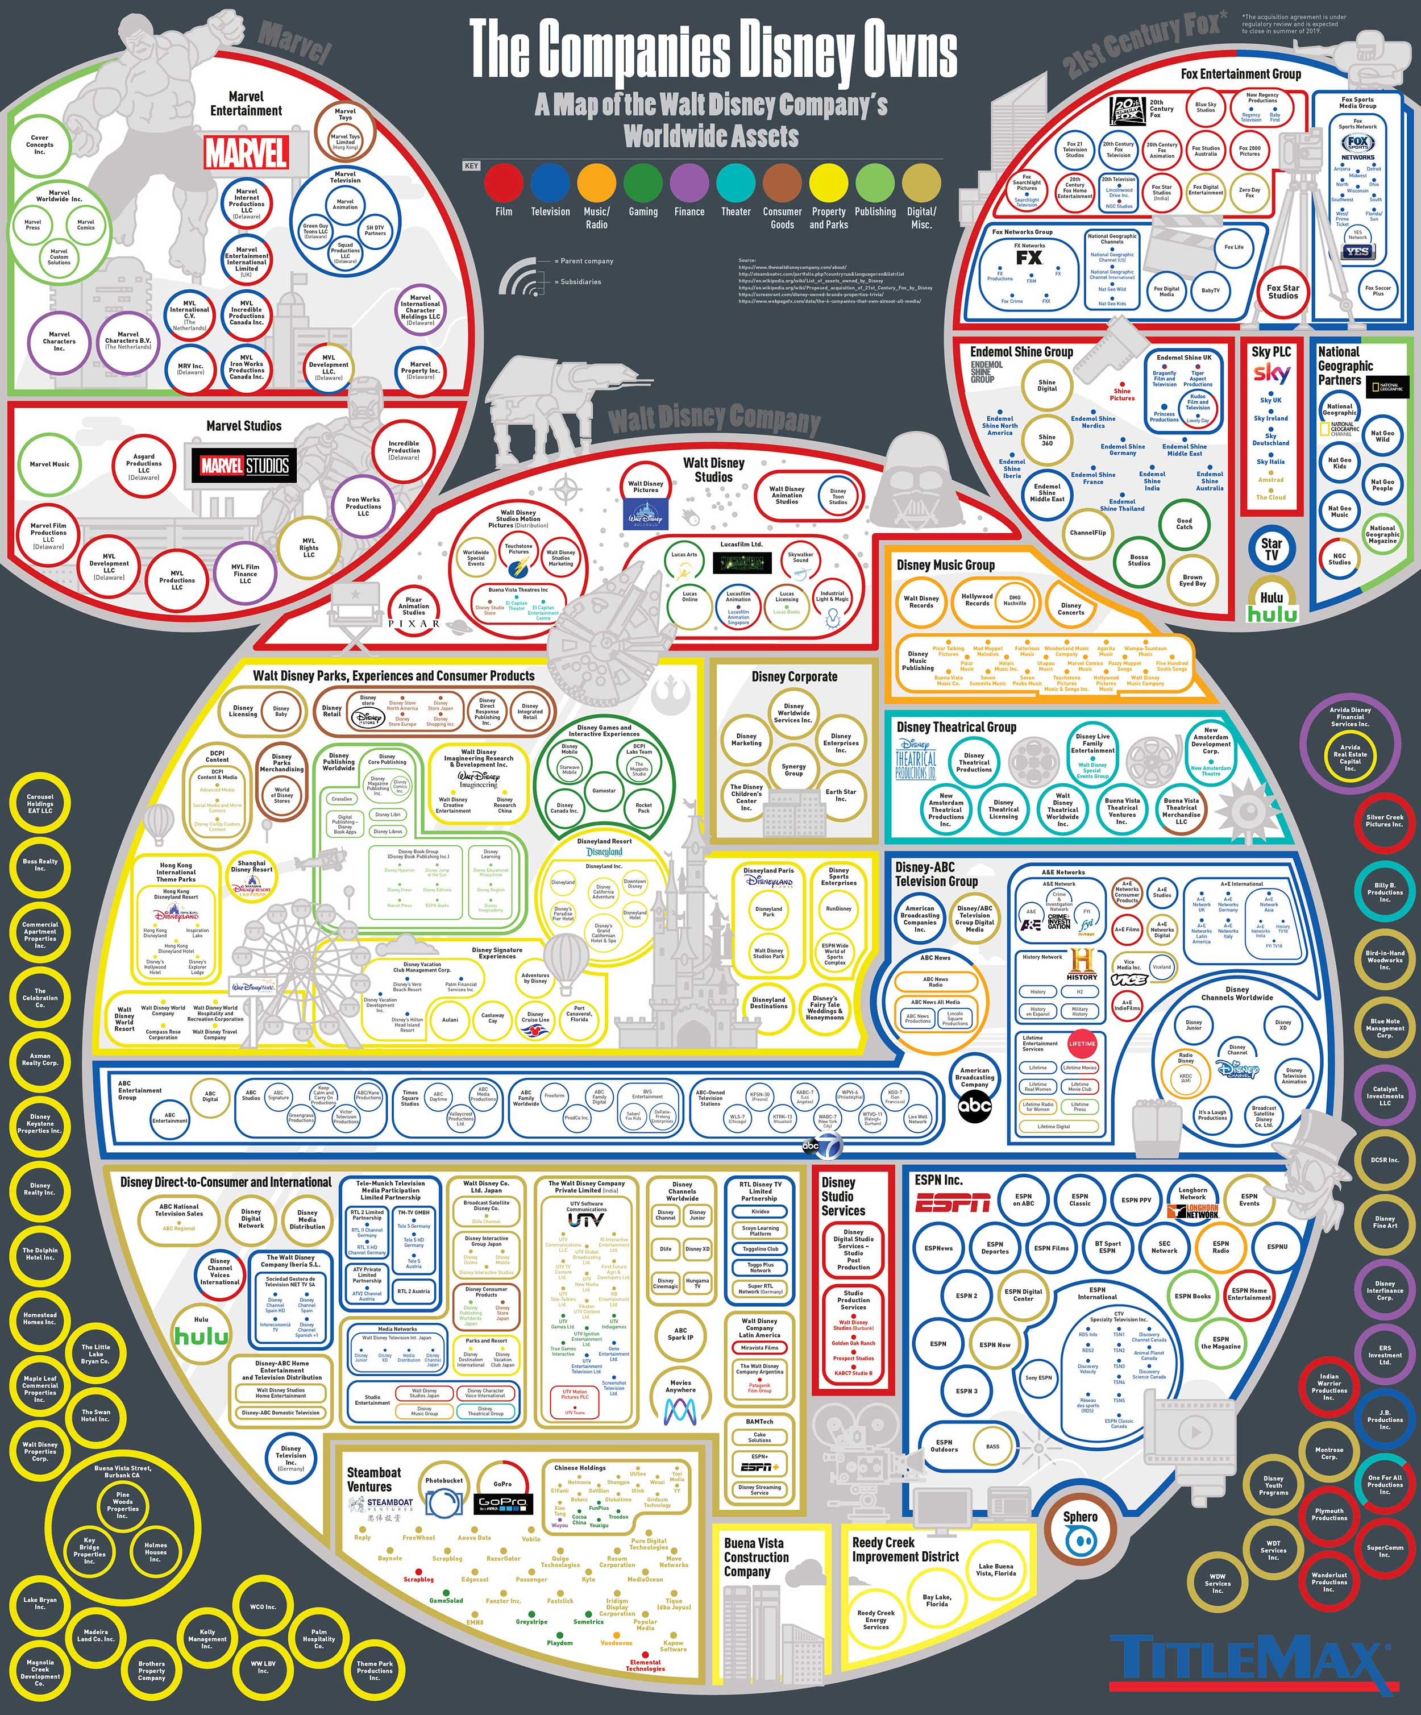

Slide 23
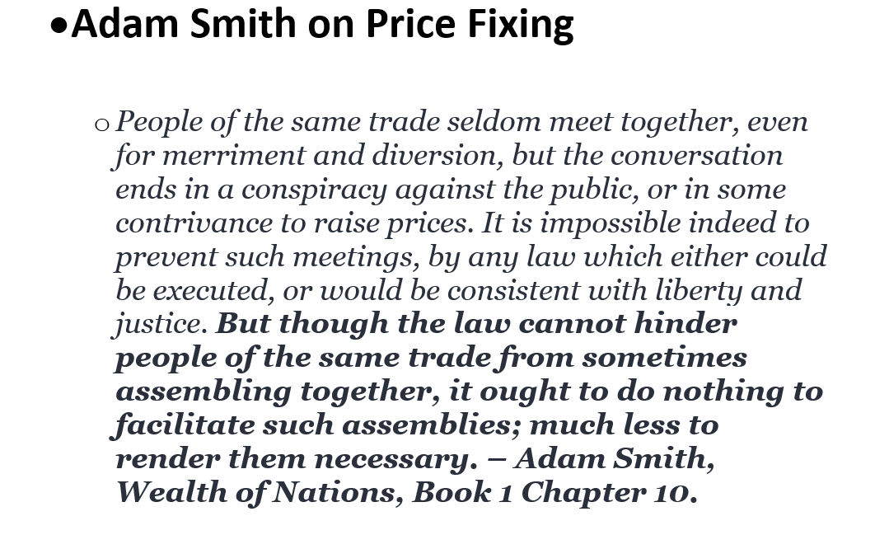

Slide 29
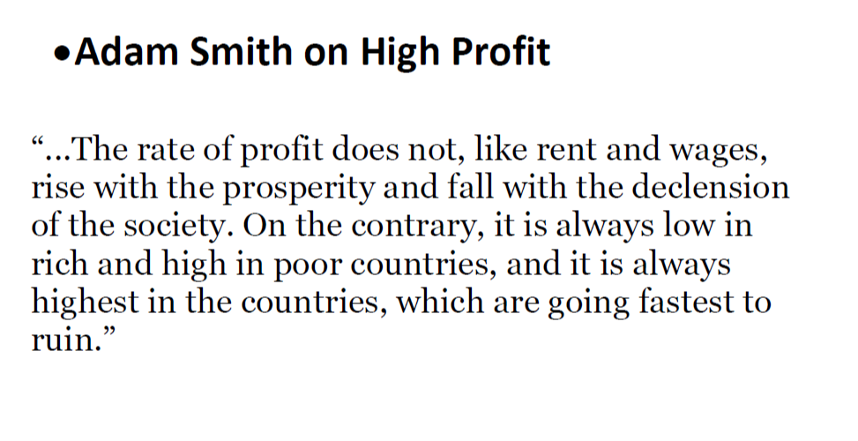

Slide 31
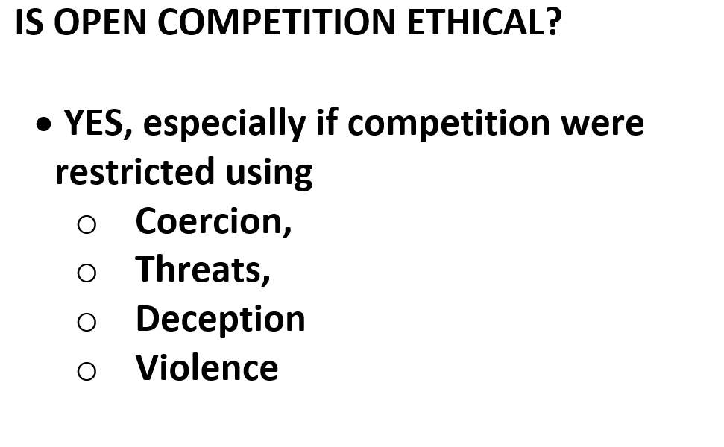

Slide 33
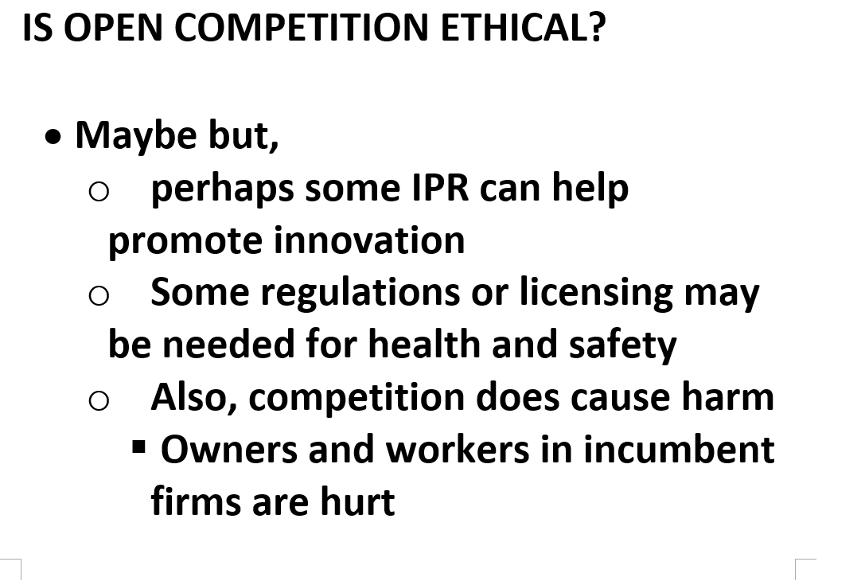

Slide 34
Friedman on Shareholder Value
“there is one and only one social responsibility of business—to use its resources and engage in activities designed to increase its profits …”
“ … so long as it stays within the rules of the game, which is to say, engages in open and free competition without deception or fraud.”

Slide 35
Government and Competition
Government can be used to promote open competition
Laws against theft, deception, violence
Antitrust laws
Government can be used to restrict competition
Licensing, allowances on exclusivity and non-compete clauses, Intellectual property, many forms of regulations
What does government actually do? BOTH!!
Government both protects consumers and market welfare, and governments injure consumers and market welfare.

