Slide 1
Supply and Demand Shifts + Market Supply Tools
Steven Suranovic
George Washington University

Slide 2
Supply/Demand in SR/LR and Supply Tools
Comparative Statics Exercises
Show equilibrium adjustments to market changes in the short-run and long-run
Will derive some useful Supply tools
Price elasticity of supply
Producer surplus

Slide 3
Comparative Statics Exercises
A Comparative Statics exercise shows how a model’s endogenous variables are affected when one of the model’s exogenous variables is changed.
These are the important cause and effect relationships we are most concerned about in economics
Comparative statics exercises are like experiments because they allow us to predict cause and effects relationships in the context of a model.

Slide 4
Exogenous vs Endogenous Variables
Exogenous variable – a model variable is exogenous when its value is determined external to the model. Its value is taken as given to the decision makers
Examples: substitute prices, household income, production input prices, etc.
Variables that shift supply or demand are exogenous
Endogenous variable – a model variable is endogenous if its value is determined in the equilibrium.
Market price and quantities are the key endogenous variables in the supply and demand model.

Slide 5
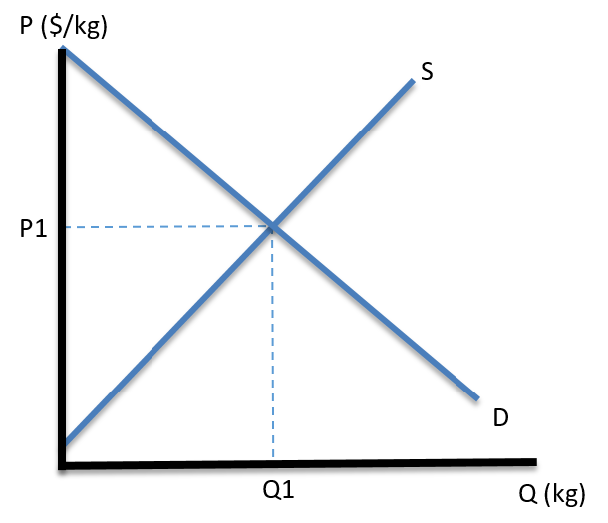
Supply/Demand Comparative Statics
Suppose the price of a substitute good rises, c.p.
PS↑ raises demand, D shifts right (show on graph)
Initially, at P1, D > S → price too low adjustment →
Eq. price rises
Eq. quantity rises

Slide 6
Supply/Demand Comparative Statics
Suppose average household income decreases and the good is normal, c.p.
I↓ lowers demand, D shifts left (show on graph)
Initially, at P1, S > D → price too high adjustment →
Eq. price falls
Eq. quantity falls

Slide 7
Supply/Demand Comparative Statics
Suppose worker wages in this industry rise, c.p.
IP↑ raises costs and S shifts up (show on graph)
Initially, at P1, D > S → price too low adjustment →
Eq. price rises
Eq. quantity falls

Slide 8
Supply/Demand Long-Run Effects
Suppose initial (P,Q) is a long-run equilibrium → firm profits = 0
Draw LR supply curve
Next, suppose the price of a complement good rises, c.p.
PC↑ lowers demand, D shifts left (show on graph)
In SR, P↓ → Losses → exit of firms → SR supply shift left
In LR, Eq. price stays the same
In LR, Eq. quantity falls

Slide 9
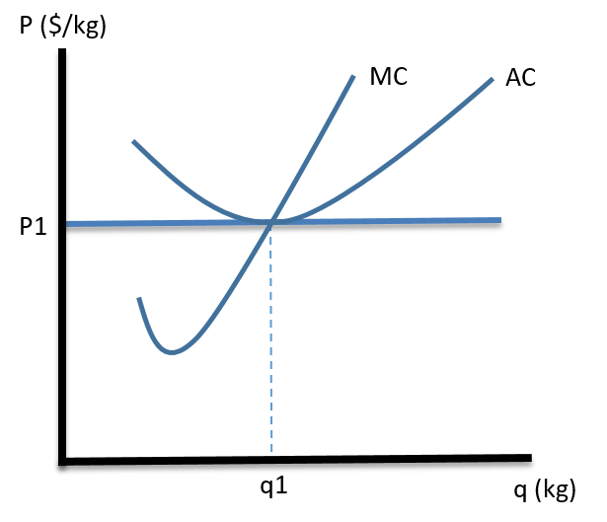
Supply/Demand Long-Run Effects
Suppose initial (P,Q) is a long-run equilibrium → firm profits = 0

Slide 10
Supply/Demand Long-Run Effects
Suppose initial (P,Q) is a long-run equilibrium → firm profits = 0
Draw LR supply curve
Next, suppose the price of a complement good rises, c.p.
PC↑ lowers demand, D shifts left (show on graph)
In SR, P↓ → Losses → exit of firms → SR supply shift left
In LR, Eq. price stays the same
In LR, Eq. quantity falls

Slide 11
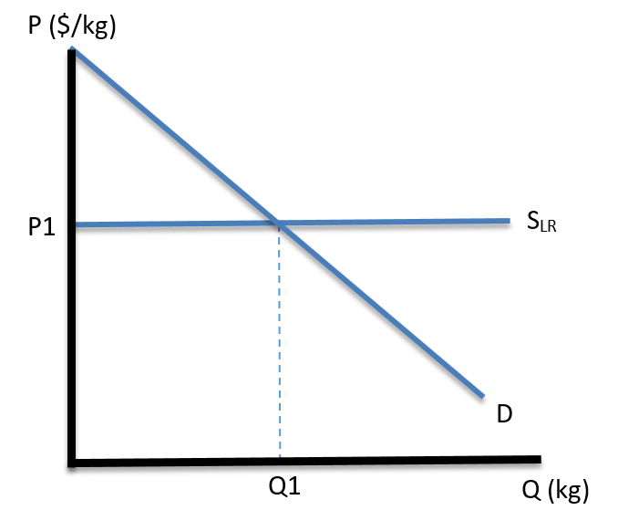
Supply/Demand Long-Run Effects
Same problem using only the LR supply curve
Suppose the price of a complement good rises, c.p.
PC↑ lowers demand, D shifts left (show on graph)
In LR, Eq. price stays the same
In LR, Eq. quantity falls

Slide 12
Supply/Demand Long-Run Effects
Suppose there is an increase in consumer demand due to an effective advertising campaign, c.p.
D shifts right (show on graph)
In LR, Eq. price stays the same
In LR, Eq. quantity rises
The entire LR adjustment process with entry is contained in the horizontal S_{LR}

Slide 13
Supply/Demand Long-Run Effects
Suppose there is a decrease in input prices (IP);
For example, fertilizer prices fall for an agricultural firm, c.p.
IP↓ causes the AC and MC curves to shift down for the rep. firm.
Show adjustment process next …..

Slide 14
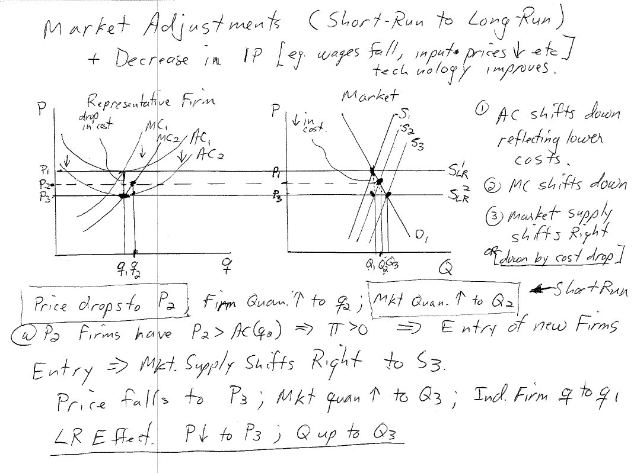

Slide 16
Supply/Demand Long-Run Effects
Again, suppose there is a decrease in input prices (IP)
→ S_{LR} shifts down by amount of the cost reduction per unit (show on graph)
LR Price falls
by the amount of the cost reduction
LR Market quantity supplied rises

Slide 17
Effects of Imperfect Information
Suppose one firm experiences a cost reduction. Perhaps due to a technological breakthrough.
The assumption of perfect info → that all firms get the same breakthru
If not, then one firm can make positive profit indefinitely (these are called economic rents .. Profit that is unearned)
→ there is an incentive by firms to keep new technologies secret
Or, protect innovations with a patent.
If so, consumers do not benefit from the innovation (only the innovator does)

Slide 18
Effects of Imperfect Information
An innovator can leverage its extra profit to secure a monopoly position
1) It can buyout other firms, thereby increasing its size in the market
By introducing the new tech., it can get positive profit from all its firms
2) It can license the technology to other firms
This is another way to appropriate the profit from other firms, who now have profit because of the new tech.
3) Sufficient mergers will give the firm market power to adjust price and quantity to increase its profit.
Non-innovating firms slowly disappear.
All of this is good for business; but bad for consumers and the market outcome

Slide 19
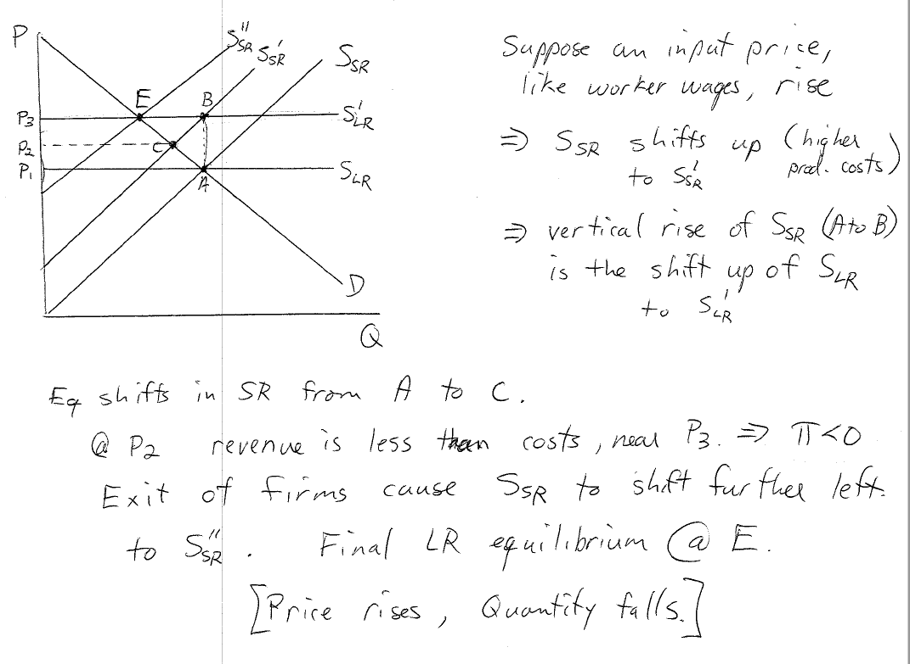

Slide 20
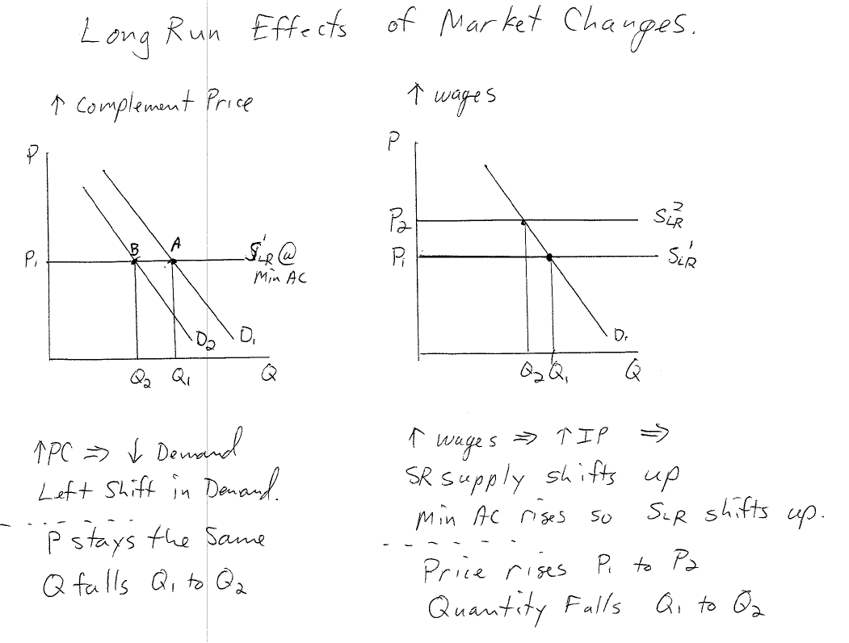

Slide 21
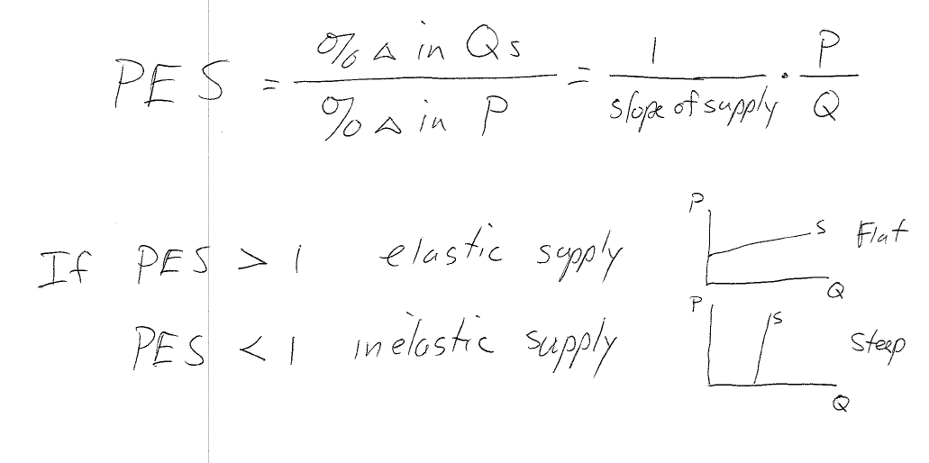
Price Elasticity of Supply

Slide 22
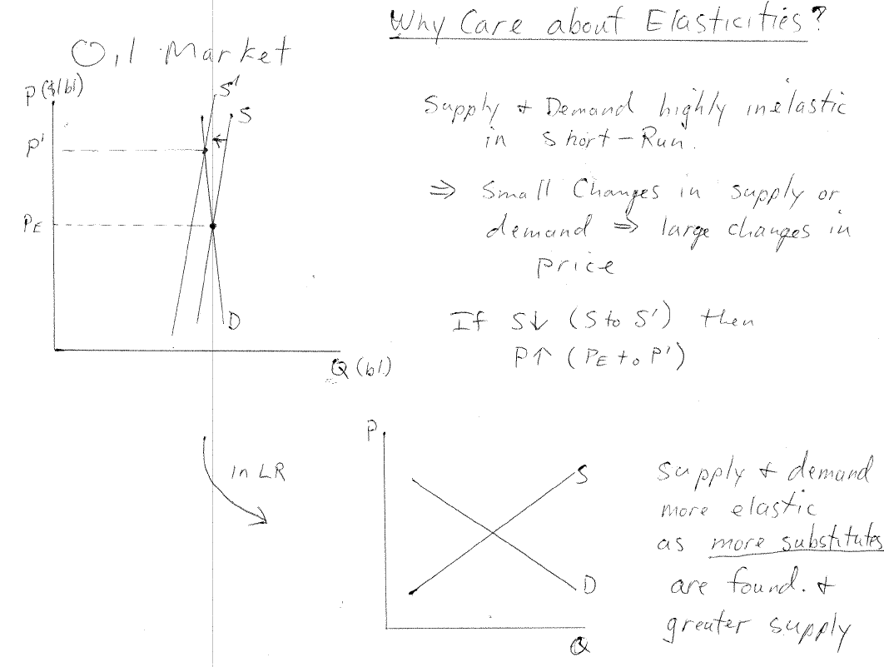
Price Elasticity of Supply

Slide 23
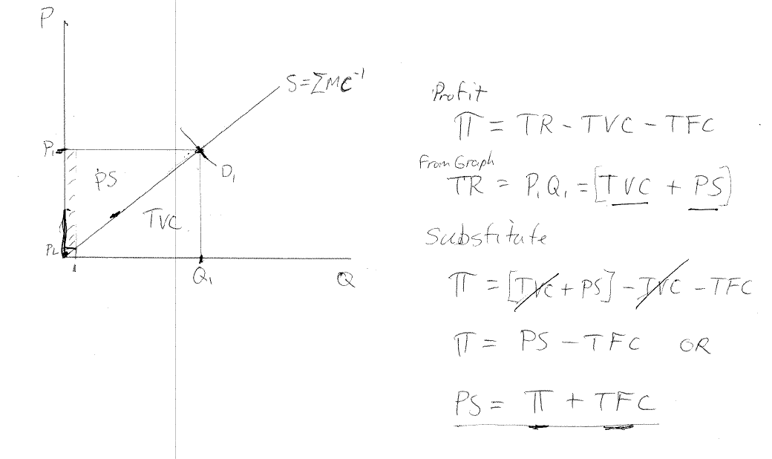
Producer Surplus

Slide 24
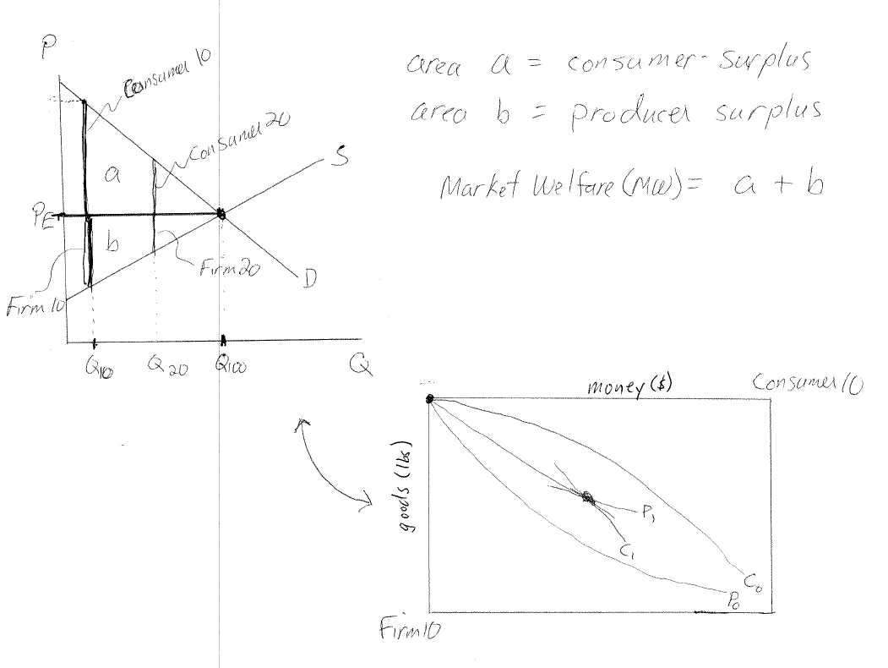
Producer Surplus

Slide 25
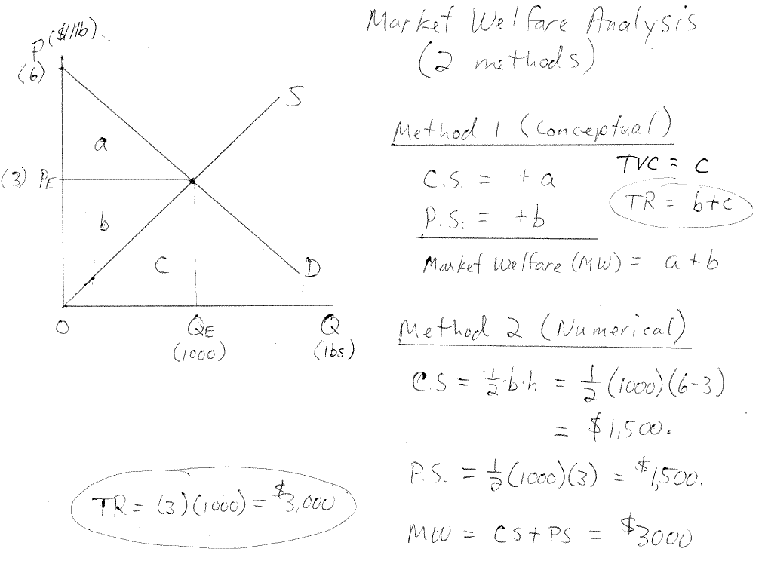
Market Welfare Analysis

Slide 26
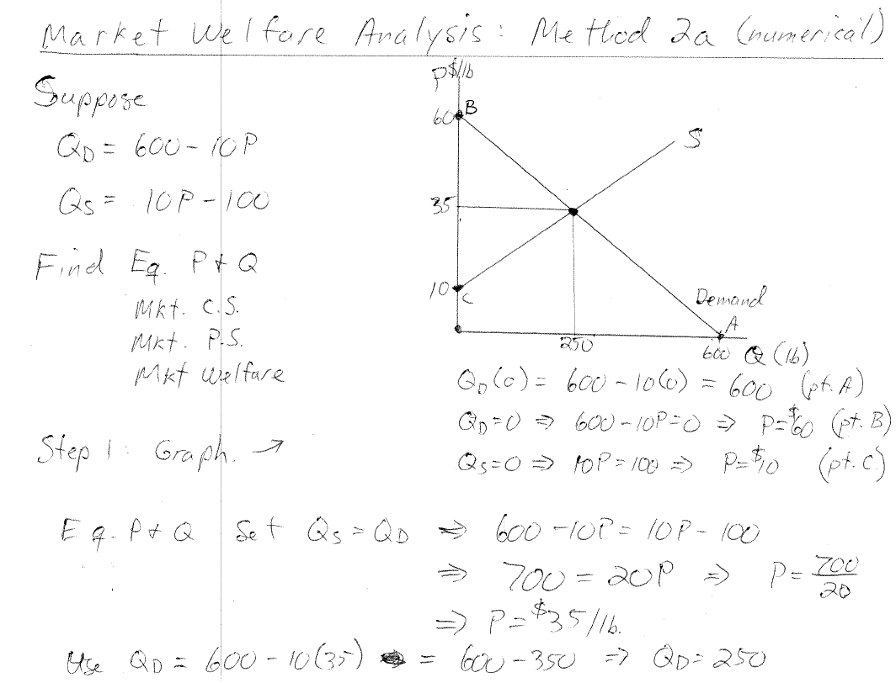
Market Welfare Analysis

Slide 27
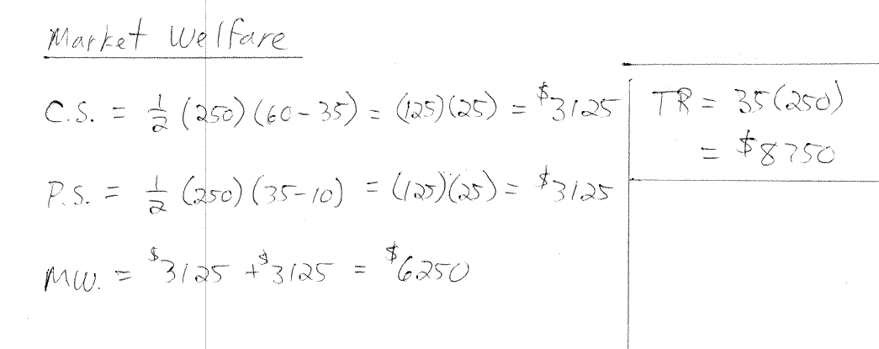
Market Welfare Analysis

Slide 28
Market Welfare Analysis

Slide 29
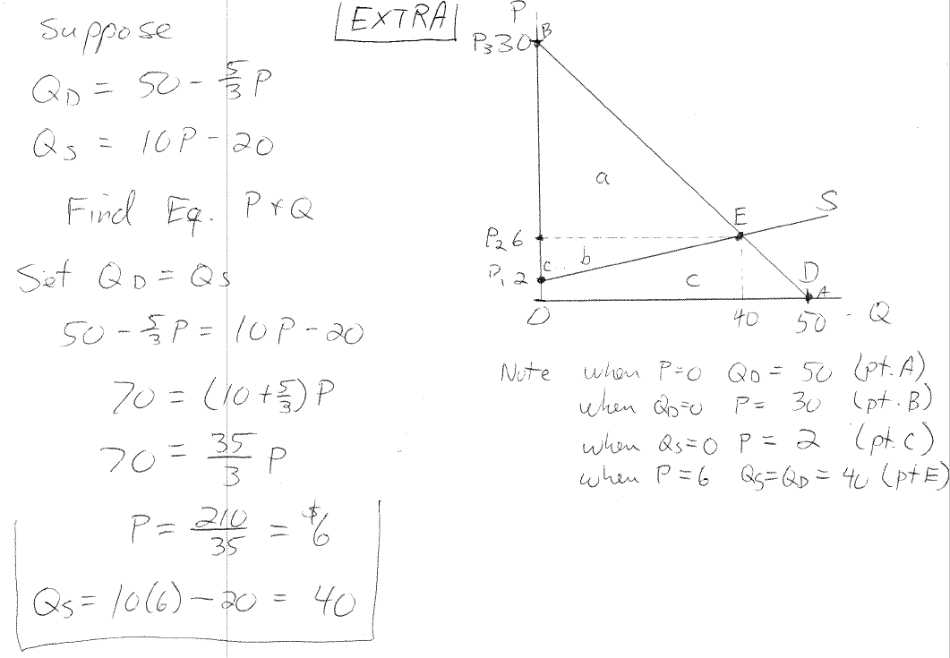
Market Welfare Analysis

Slide 30
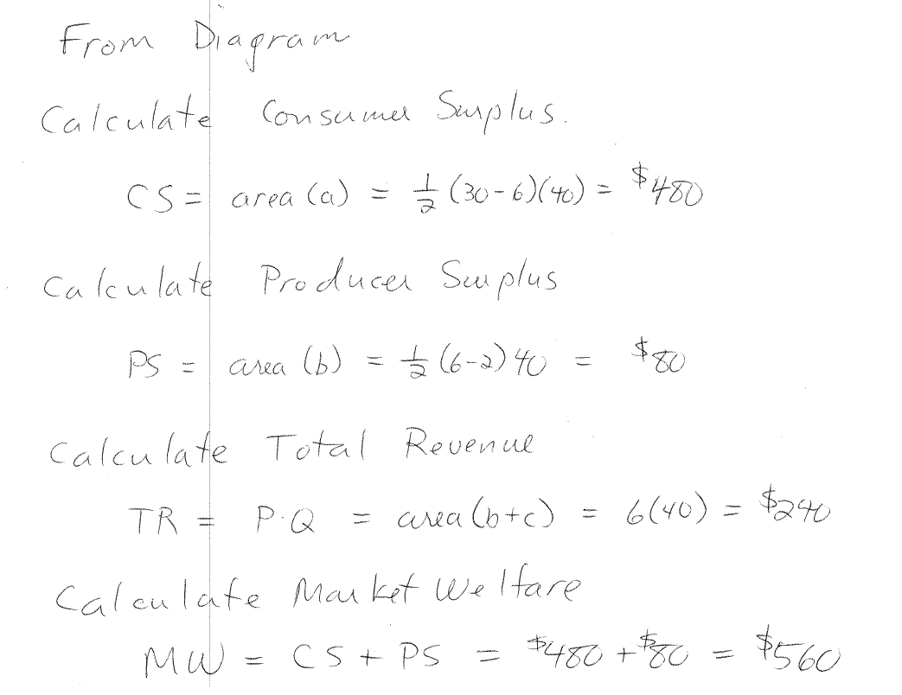
Market Welfare Analysis

