Slide 1
Theory of Monopoly
Steven Suranovic
George Washington University

Slide 2
Monopoly Definition
One firm supply a product to a market
No competition from other firms
Reasons
Monopolized Inputs
Eg. DeBeers owned all the diamond mines ….
Natural Monopolies
Electricity, Phone, with large fixed costs and economies of scale
Government Created
Intellectual Property – patents, trademarks, copyrights
Government-owned enterprises

Slide 3
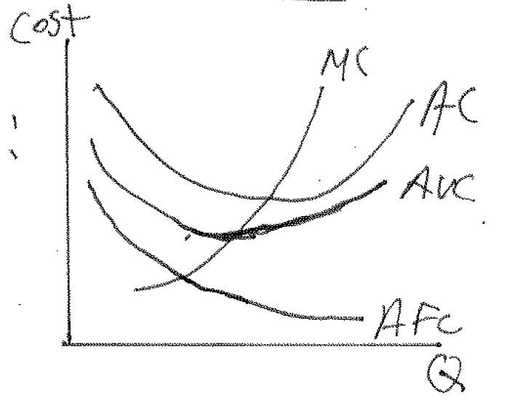
Monopoly Market Assumptions
Firm Cost Functions look like:
Many consumers with a negatively-sloped market demand curve
Demand affected by I, PS, PC, etc.

Slide 4
Monopoly Market Assumption/Implication
Assume the firm is motivated to maximize profit
Then ..
Firm Chooses output level such that,
MR(Q) = MC(Q)
marginal revenue = marginal cost
Note: There is only one Q that satisfies this profit-maximizing condition

Slide 5
Marginal Revenue
MR is derived from the market demand curve
Recall: Total Revenue (TR) = P x Q
MR = ΔTR / ΔQ (units: $/unit of output, eg. $/lb)
that is, the change in total revenue given a change in the quantity demanded/supplied, noting that a firm can only supply as much as is demanded at a particular price.

Slide 6
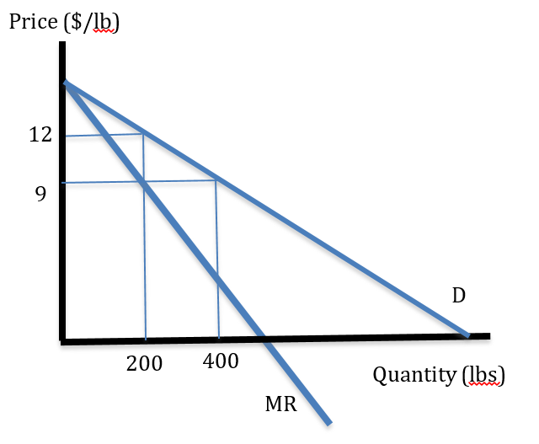
Marginal Revenue
TR(200) = 12(200) = $2400
TR(400) = 9(400) = $3600
MR = (3600 – 2400)/(400 – 200)
= 1200/200 = $6/lb
(show on graph)

Slide 7
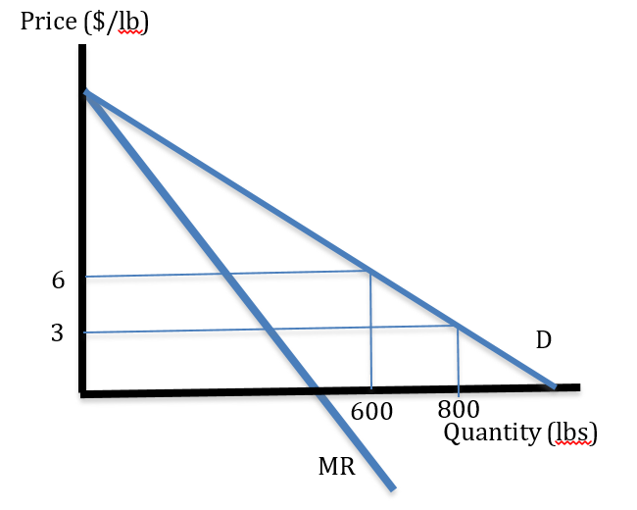
Marginal Revenue
TR(600) = 6(600) = $3600
TR(800) = 3(800) = $2400
MR = (2400 – 3600)/(800 – 600)
= -1200/200 = - $6/lb
(show on graph)

Slide 8
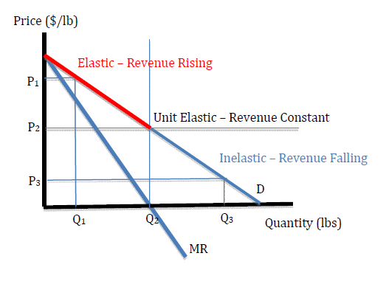
Marginal Revenue
MR > 0
in the elastic range of demand
MR < 0
in the inelastic range of demand
MR = 0
at midpoint of demand curve
Remember MR is measured on vertical axis.

Slide 9
Diamond Monopoly Example
Assume a market for diamonds given by the demand schedule on the next page
Assume the marginal cost of diamond production is fixed at $1000 per diamond (constant MC)
Assume there are no fixed costs
Since MC is fixed … MC = AC, thus TC = MC x Q

Slide 10
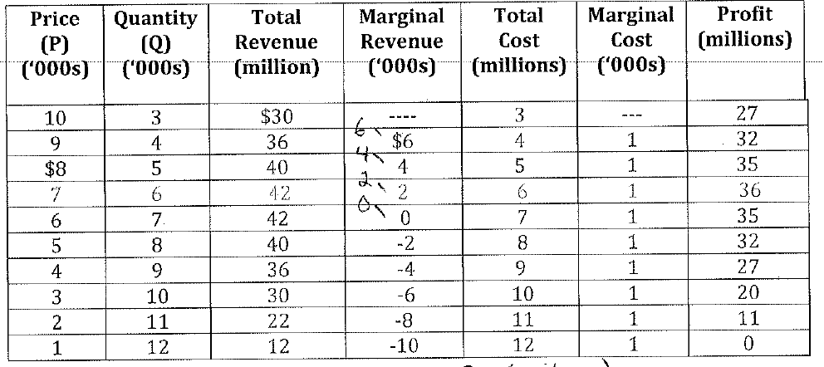
Diamond Monopoly Example

Slide 11
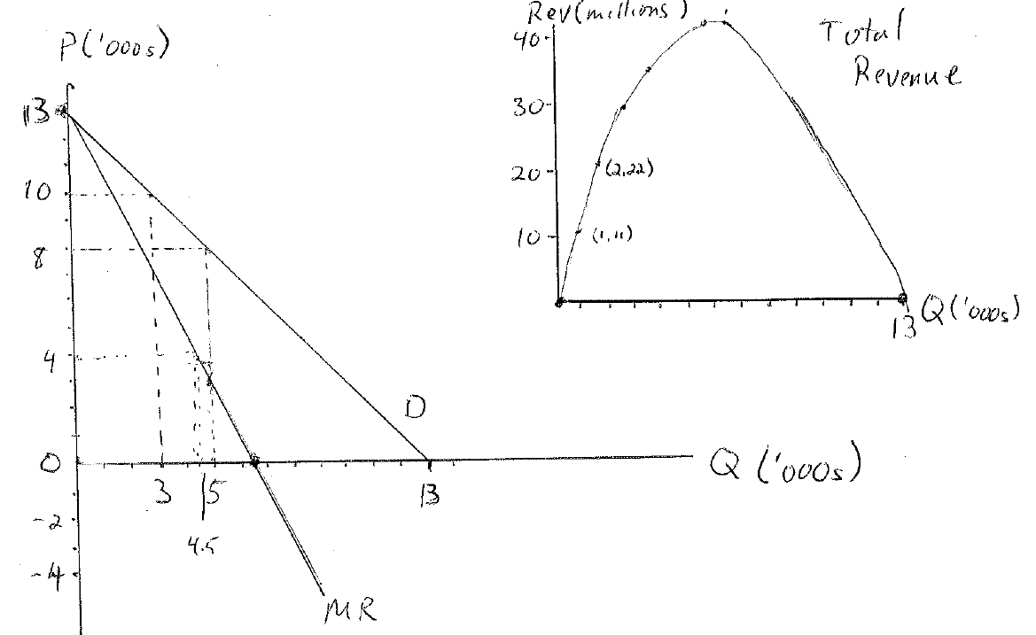
Diamond Monopoly: Graphs

Slide 12
Diamond Monopoly Example
On Previous diagram show:
Where MR = MC
How to find the profit-maximizing price and quantity
How to determine the profit-maximizing total revenue
How to determine the profit-maximizing total cost
How to determine the profit-maximizing profit

Slide 13
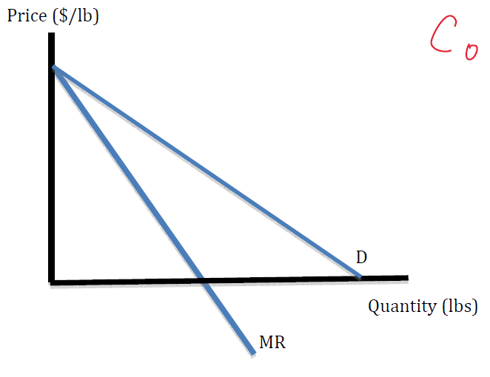
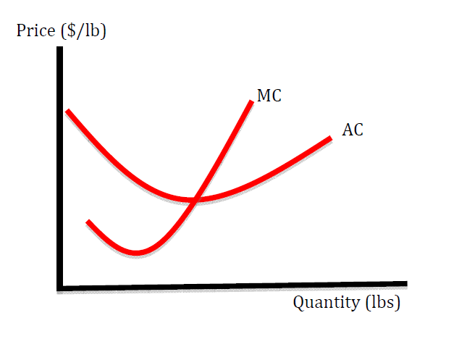
Monopoly: General Case
Consumer Demand Side
Producer Supply Side

Slide 14
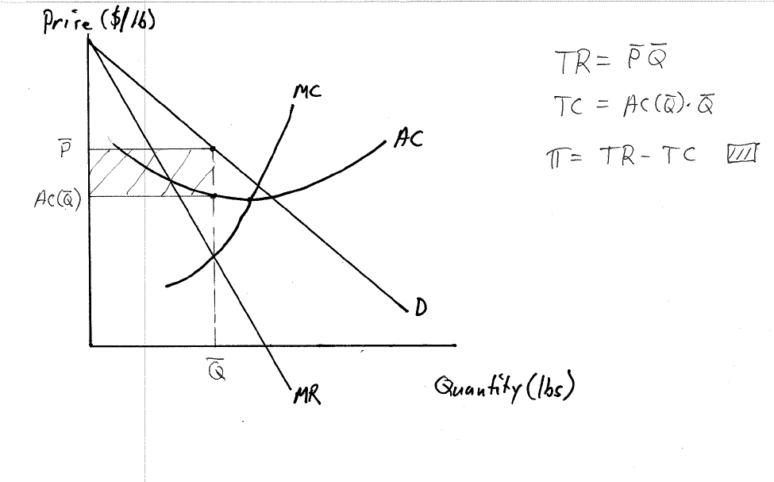
Monopoly General Case
Put the supply and demand sides together
Determine profit-max output, Q, where MR = MC
Find price, P, on the demand curve

Slide 15
Monopoly General Case
Prove Qbar is the profit maximum
If Q < Qbar then MR > MC → increasing Q will raise profit
If Q > Qbar then MC > MR → increasing Q will lower profit

Slide 16
Monopoly General Case
Note how to find
TR = P x Q
TC = AC x Q
Profit
Consumer surplus

Slide 17
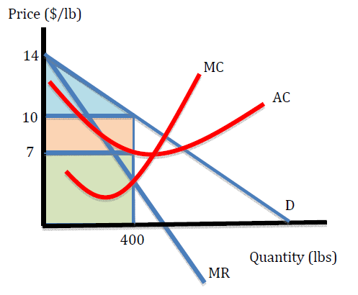
Monopoly: General Numerical Example
Identify/Calculate
Profit Max Q and P
TR =
AC =
TC =
Profit =
Consumer surplus
Market Welfare = π + CS

Slide 18
Price Discrimination
PD means setting a different price for different consumers.
Method for a firm to capture consumer surplus to raise its own profit
Ideally, a firm would like to charge each consumer just less than that consumer’s individual willingness to pay.

Slide 19
Price Discrimination
Perfect PD occurs if every consumer is charged their own maximum price
Tell truth-serum story …… suppose a seller can give each customer a truth serum whereupon she is asked how much she is willing to pay for a good. The merchant then sells for just less than that.
Not a realistic possibility so firms look to other imperfect PD methods
Movie ticket discounts for seniors and children
Airline ticket price differences based on when one leaves and returns,
etc. etc.

