Slide 1
Theory of Oligopoly
Steven Suranovic
George Washington University

Slide 2
Effects of Competition
Monopoly to Duopoly (2 firms)
Effects of Duopoly (on prices, profits, welfare)
Duopoly to Oligopoly (Small number of firms)
Game Theory – Prisoner’s Dilemma

Slide 3
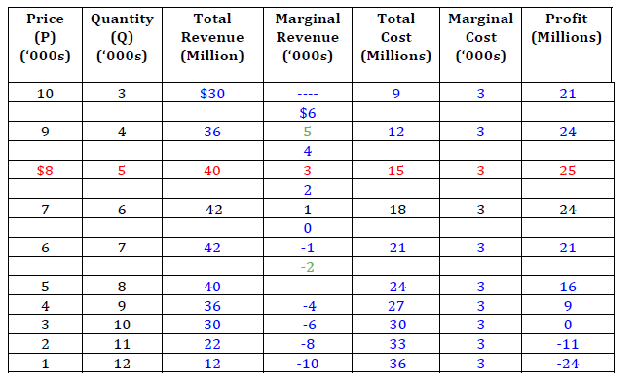
Start with Monopoly Again
MC = $3000
No Fixed Costs
Monopoly outcome
Q = 5,000
P = $8,000
π = $25 million

Slide 4
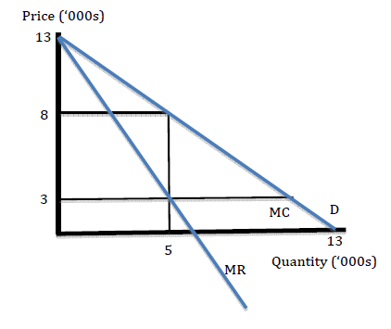
Monopoly with Equations and a Diagram
MC (Q) = $3000
MR(Q) = 13 – 2Q
Q = 5,000
P = $8,000
TR = $40 million
TC = $15 million
π = $25 million

Slide 5
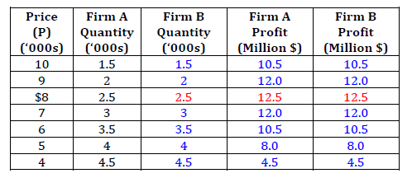
Monopoly with Two Owners
Suppose a brother and sister take over the family business
Siblings operate as a cartel, a collusive agreement where they act as one firm
Siblings split output equally in two separate factories
Cartel, Collusion, Price-Fixing, Mergers are all associated with monopolizing behavior

Slide 6
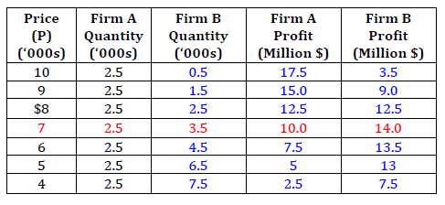
Two Owners with a Disagreement
Suppose the brother in Firm B decides to cheat on the agreement
B decides to max own profit assuming A remains fixed at original Q
Effects next page

Slide 7
Two Owners with a Disagreement
B’s max profit is to produce 3.5K, up from 2.5K
Market Price falls to $7K; down from $8K
Output rises by 1000
B’s profit is $14M; Up from $12.5M
A’s profit falls to $10M; down from $12.5M

Slide 8
Two Owners with a Disagreement
Breakup of a cartel
Consider OPEC cartel in 1980s and 90s
Some countries, like Kuwait were known to exceed their quota → lower oil prices and lower profits
Other OPEC countries like Iraq under Sadaam Hussein were upset by this behavior
Led to the Iraqi invasion of Kuwait in 1990
Upon defeat, Iraq set oil fields on fire.

Slide 9
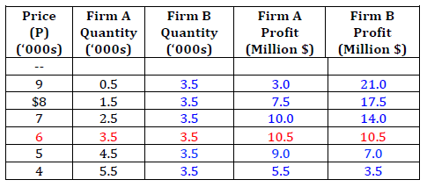
Two Owners with a Disagreement
Suppose the sister notices B’s cheating and does what’s best for herself
She takes B’s Q as fixed at 3,500 and max’s profit
Effects next page

Slide 10
Two Owners with a Disagreement
A’s max profit is to produce 3.5K, up from 2.5K
Market Price falls to $6K; down from $7K
A’s profit is $10.5M; Up from $10M
B’s profit falls to $10.5M; down from $14M

Slide 11
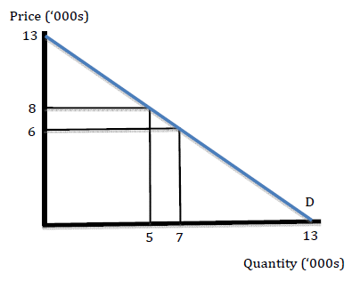
Duopoly vs Cartel (Monopoly)
Price falls from $8000 to $6000 per diamond
Total diamond production rises from 5,000 to 7,000
Remember: competition causes price to fall and output to rise

Slide 12
Duopoly vs Cartel (Monopoly)
Total profit falls from $25M to $21M
Individual profit falls from $12.5M to $10.5M
The incumbent firms (A and B) both lose when the cartel breaks
Competition causes a drop in firm profit

Slide 13
Duopoly vs Cartel (Monopoly)
Consumer surplus
CS w/cartel = ½(13 – 8)(5) = $12.5 million
CS w/duopoly = ½(13 – 6)(7) = $24.5 million
Competition causes an increase in diamond consumer welfare

Slide 14
Duopoly vs Cartel (Monopoly)
Total Market Welfare = π + CS
MW w/cartel = 25 + 12.5 = $37.5 million
MW w/duopoly = 21 + 24.5 = $45.5 million
Competition causes overall market welfare to rise

Slide 15
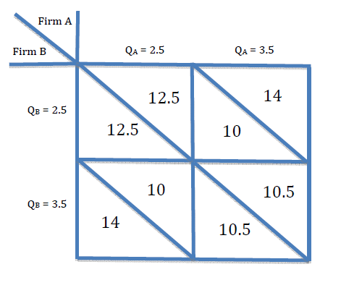
Game Theory w/ Duopoly
Consider a game with two players, Firms A and B
Assume each firm has two strategies: Q = 2.5K or Q = 3.5K
Assume the payoffs (number in the boxes) represent firm profits

Slide 16
Game Theory w/ Duopoly
Dominant Strategy – best choice regardless of what the other does
Q = 3.5 is dominant for both
Non-cooperative equilibrium aka Nash equilibrium

Slide 17
Game Theory w/ Duopoly
Prisoner’s Dilemma outcome
Each do what’s in their own best interest and yet achieve an outcome that is worse for both
How to achieve the better outcome?

Slide 18
Game Theory w/ Duopoly
Cooperation
Cooperative equilibrium maximizes joint (or total) welfare
Q = 2.5 for both yields total profit = $25 million
Cooperative agreement here is collusion/cartel
Best outcome for consumers/market welfare is the Nash Eq.

