Slide 1
Positive Externalities and the Coase Theorem
Steven Suranovic
George Washington University

Slide 2
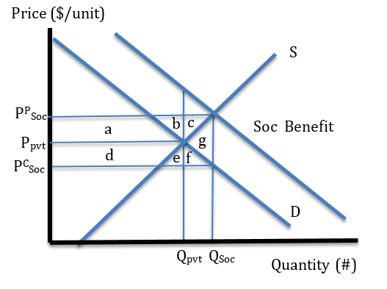
Positive Externality Case
Consider a market for wind turbines
The free market, or private, outcome occurs at price P_{pvt} and quantity Q_{pvt}
Suppose production of wind turbines causes positive external effects (by reducing carbon emissions)
Let Social Benefit = Pvt Ben + Externality benefit
The vertical distance between SB and D is the externality benefit per unit produced

Slide 3
Positive Externality Case
Intersection of marginal social benefit with the supply curve, representing marginal cost, determines the socially optimum output level, Q_{soc}
Note that Q_{soc} > Q_{pvt} which means that private, free market, decisions will result in underproduction and a reduction in economic efficiency

Slide 4
Positive Externality Case
The government can achieve the social optimum with a subsidy that will increase production to Q_{soc}
Set the subsidy S = P^{P}_{soc} – P^{C}_{soc}
Because this is the subsidy rate needed to get the quantity to Q_{soc}
Consumer price falls → demand rises
Producer price rises → supply rises

Slide 5
Positive Externality Case
Welfare Effects
Externality Effect Before the tax
+ a + b + d + e
Externality Effect After the tax
+ a + b + c + d + e + f + g
ΔExt Eff = + c + f + g

Slide 6
Positive Externality Case
Welfare Effects
ΔCS = + d + e + f
ΔPS = + a + b + c
ΔGR = - (a + b + c + d + e + f + g)
ΔExt Eff = + c + f + g
ΔMW = c + f = g

Slide 7
Positive Externality Case
Welfare Effects
Although the subsidy causes deadweight losses (g) the benefit created by increasing turbine supply outweighs the subsidy inefficiency and causes a rise in market welfare (c + f)
In other words, a government subsidy can raise economic efficiency when it corrects for a positive externality
Also means the free market outcome is inefficient

Slide 8
Non-Government Correction of Externalities
General Result is that government can correct for either negative or positive externality effects with an appropriately set tax or subsidy
However some have suggested (Ronald Coase et.al.) that externality problems can be solved via cooperative arrangements by the private parties themselves
In principle, this is similar to the Elinor Ostrom result concerning common resources

Slide 9
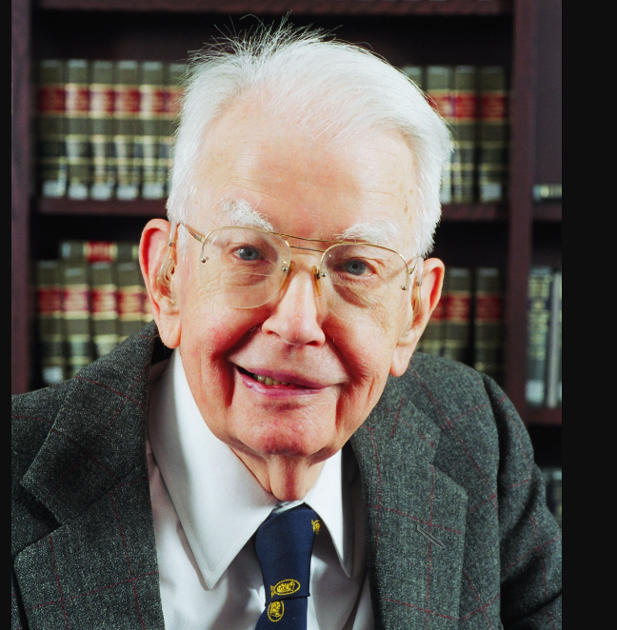
Ronald Coase (1910 – 2013)
Nobel Prize 1991
Chicago School economist
Known for work on the Nature of the Firm explaining why transactions costs makes firm existence necessary
Also known for the “Coase Theorem” which argues that externality problems can be solved by assigning property rights appropriately and allowing bargaining

Slide 10
The Coase Theorem
Consider a chemical plant that causes air pollution which injures people in the local community
Coase considers the following question: Who owns the atmosphere?
Quick answer: No one owns it … it can be used or abused freely
Coase identifies this as a problem …. The solution of which is to imagine how things could change if property rights were assigned to someone

Slide 11
The Coase Theorem
Consider the following payoff matrix for chemical firms and the local community
The chemical firm can either choose to pollute freely or it could implement emission scrubbers and eliminate pollution at a cost

Slide 12
The Coase Theorem
In this case, the firm does best if it pollutes, while the community’s best outcome is if the firm does not pollute
Note that the numbers are chosen so that the best social outcome is for the firm not to pollute
How to achieve to best outcome?

Slide 13
The Coase Theorem
In the first scenario, suppose we allocate the property rights over the atmosphere to the firm
The firm would choose to pollute in this case
But suppose the community offers a transfer (bribe) - to pay the firm $30 if it will choose not to pollute instead

Slide 14
The Coase Theorem
The far right column shows that with the transfer the firm will get 105 (> 100) and the community will get -30 (> -50)
Thus, both sides gain from the deal
Also, the deal assures that the best outcome for society is realized.

Slide 15
The Coase Theorem
In the second scenario, suppose we allocate the property rights over the atmosphere to the community
Now the community would demand that the firm not pollute
If the firm violates the demand, the community could use the courts to enforce their property rights
Again in this case, the best social outcome is realized

Slide 16
The Coase Theorem
According to Coase,
The allocation of property rights provides the legal authority to bargain over the outcome
the social outcome is realized regardless of who owns the atmosphere
But, the distributional effects differ: It is clearly better to be the owner of the resource

Slide 17
The Coase Theorem
According to Coase,
The allocation of property rights provides the legal authority to bargain over the outcome
the social outcome is realized regardless of who owns the atmosphere
But, the distributional effects differ: It is clearly better to be the owner of the resource

Slide 18
The Coase Theorem
Consider an alternative payoff matrix for chemical firms and the local community
In this case, the cost of pollution to the community is much smaller
If the firm owns the atmosphere, it will choose to pollute
This is also the best social outcome

Slide 19
The Coase Theorem
The community could not afford to transfer money to the firm to induce it to change its decision
Why? Because the firm needs > 25 to change (eg. 26)
The community would get -26 with this deal which is < -10

Slide 20
The Coase Theorem
Next, suppose the community owns the atmosphere
In this case they would insist the firms not pollute
But the firm could offer the community a transfer (build parks, pay higher taxes, etc) of $20 to allow it to pollute
Community agrees because with the transfer +10 > 0

Slide 21
The Coase Theorem
The transfer again generates the socially best outcome
Again, distributionally, it is best to own the resource
But, one might ask why these types of arrangements are rare …. Answer: Transactions costs
See the posted article on seat reclining in airplanes

Slide 22
The Coase Theorem
Who owns the space taken by a reclining seat on an airplane?
Deciding sometimes results in conflict between passengers
Why don’t passengers bargain over the rights to the space? … because of transactions costs!
Bargaining here is not customary … awkwardness is a cost
It is awkward to communicate with each other
It is awkward to make payment

Slide 23
The Coase Theorem
Transactions costs may prevent many private deals that solve externality problems
If transactions costs could be lowered, then bargaining offers a method to solve externality problems with a private market mechanism
Many institutions and businesses were established because they reduce transactions costs
Laws prohibiting deceptive market practices reduce the costs of trading. Therefore, trades are less risky
Google maps makes it easier to find restaurants and shops
Etc Etc …….

Slide 25
The Coase Theorem
Recall the Edgeworth box model when intermediaries were introduced
They can raise welfare only when they provide services to reduce transactions costs. eg., Amazon
Also Douglass North argued that institutions (eg, religions, government, police, etc) act to reduce “transactions costs” and thereby makes trade easier.
For example, I might not loan money to Smith because he might not pay me back. But if I can use the judicial system to sue Smith if he doesn’t pay, then I am willing to lend

Slide 26
Pecuniary vs Non-pecuniary Externalities
Pecuniary Externalities (PE) – these are negative or positive effects upon others within interconnected markets
A firm who loses from the entry of a competitor
The covid pandemic caused a shift in demand for masks and PPE
Non-Pecuniary Externalities – these are the previously described externalities

Slide 27
Pecuniary vs Non-pecuniary Externalities
In general Pecuniary Externalities reflect a normal creative destruction process (Schumpeter) in a dynamic economy and do not require solutions, either public or private
This is because these unexpected gains or losses do not result in losses in economic efficiency
Instead interventions serve merely to redistribute from winners to losers
Correction of pecuniary externality effects is an attempt to guarantee the status quo

Slide 28
Conclusion
A non-pecuniary externality is a market imperfection that can be corrected for with an appropriate government tax or subsidy
The government must be able to make good estimates of the costs and benefits or else it may set the tax or subsidy at a welfare-reducing level
The Coase theorem shows that bargaining by market participants offers an alternative to government to solve the externality problems
However, high transactions costs will often make the private solution difficult to implement

