Slide 1
Government Taxes and Subsidies
Steven Suranovic
George Washington University

Slide 2
Definitions
A tax is a government fee collected from individuals or businesses based ownership, income, or some specified action.
A subsidy is a government payment made to individuals or businesses based ownership, income, or some specified action.

Slide 3
Types of Taxes and Subsidies
Taxes include, income taxes, property taxes, social security taxes, sales taxes, profit taxes, import taxes (tariffs), commodity taxes, etc.
Subsidies include agricultural subsidies, energy subsidies, housing subsidies, healthcare subsidies, export subsidies, etc.

Slide 4
Types of Taxes and Subsidies
Taxes and subsidies can be implemented in two basic ways
Ad valorem – this is assessed as a percentage of the value of something. (% of sales, % of imports, % of profit, etc.)
Specific – this is assessed as a dollar charge per unit (eg. a tariff of 3.9 cents per kilogram on tomato imports; or, 18.3 cents per gallon of gasoline, etc.)
The tax/subsidy can be assessed on the amount produced, the amount consumed, or the amount traded.

Slide 5
The Purpose of Taxes and Subsidies
The primary purpose of taxes is to collect revenue needed to run government operations. (e.g., income taxes)
The secondary purpose of taxes is to discourage some particular action or behavior (e.g. pollution and cigarette taxes)
The primary purpose of subsidies is to encourage particular activities or outcomes (e.g., solar energy subsidies, housing subsidies for low income families, etc.)

Slide 6
Our Analysis of Taxes and Subsidies
We will not analyze all types of taxes and subsidies … too complex. Take a public finance course to learn more)
Instead we will consider a simple specific tax and subsidy assessed per unit of a particular good traded in a market
Much like a gasoline tax or an alcohol tax…
The effects shown will be similar to the effects of other types of taxes and subsidies (such as ad valorem, property, income, etc.)

Slide 7
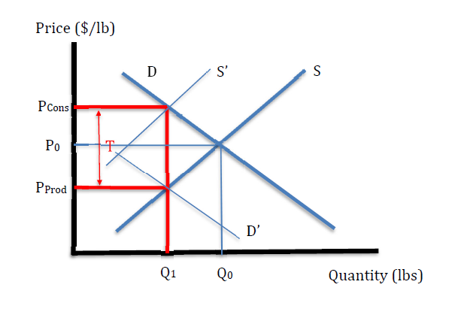
Price and Quantity Effects of a Production Tax
First, suppose a specific tax of T ($/lb) is imposed on production in a market
In diagram T = P_{Cons} - P_{Prod}
Originally to induce production of Q₁, producers must get the price P_{Prod}
With tax T, producers must receive P_{Cons} to induce Q₁ production

Slide 8
Price and Quantity Effects of a Production Tax
Supply curve S’ is shifted up by T to reflect the extra tax that must be paid by producers at each quantity produced
S’ is a function of the market price
The intersection of S’ and D determines the equilibrium price (P_{Cons}) and quantity (Q₁)
Firms do not receive the market price though. They pay the tax T and receive only P_{Prod}

Slide 9
Price and Quantity Effects of a Production Tax
P_{Cons} is the market price, or the price paid by consumers at the market. (i.e., price on the price tag)
P_{Prod} is the price received by producers after paying the tax
Consumer price rises with tax
Producer price falls with tax
Quantity traded falls with tax

Slide 10
Price and Quantity Effects of a Consumption Tax
Next, suppose a specific tax of T ($/lb) is imposed on consumption in a market
In diagram T = P_{Cons} - P_{Prod}
Originally to induce consumption of Q₁, consumers must get the price P_{Cons}
With tax T, consumers must pay P_{Prod} to induce Q₁ consumption

Slide 11
Price and Quantity Effects of a Consumption Tax
Demand curve D’ is shifted down by T to reflect the extra tax that must be paid by consumers at each quantity consumed
D’ is a function of the pre-tax or producer price
The intersection of S and D’ determines the equilibrium producer price (P_{Prod}) and quantity (Q₁)
Consumers do not pay the producer price though. They pay the tax T too, or P_{Cons}

Slide 12
Price and Quantity Effects of a Consumption Tax
P_{Cons} is the market price, or the price paid by consumers at the market. (i.e., price on the price tag including the tax)
P_{Prod} is the price received by producers
Consumer price rises with tax
Producer price falls with tax
Quantity traded falls with tax

Slide 13
Equivalence of a Production and Consumption Tax
The outcome is the same regardless of who is taxed
No need to shift the curves, and reinterpret them, to find new equilibrium
Instead find a Q such that the vertical distance between D and S = T
This way demand and supply remains functions of their own prices

Slide 14
Equivalence of a Production and Consumption Tax
Notice that the tax drives a wedge between P_{Cons} and P_{Prod} such that
P_{Cons} = P_{Prod} + T
Also, S(P_{Prod}) = D(P_{Cons}) = Q₁
Show how the bigger the tax, the bigger the wedge, and the lower the quantity.

Slide 15
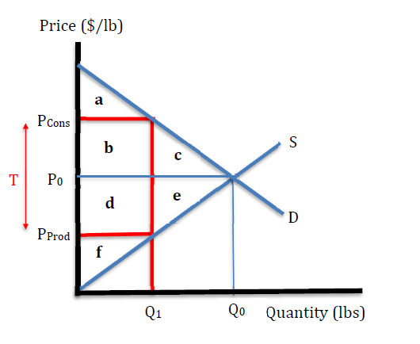
Welfare Effects of a Tax
Before Tax Welfare
CS = a + b + c
PS = d + e + f
MW = a + b + c + d + e + f
Change in Welfare from Tax
ΔCS = - (b + c)
ΔPS = - (d + e)
Tax Revenue = + b + d
ΔMW = - (c + e)

Slide 16
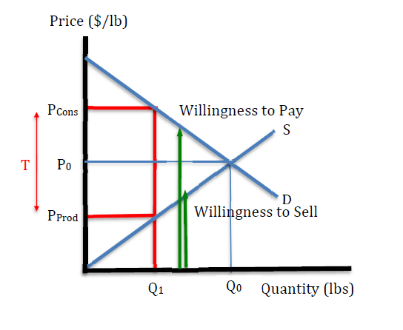
Welfare Effects of a Tax
Net Negative Effects labelled “deadweight losses” or efficiency losses
Losses associated with mutually voluntary trades that do not occur after the tax
Losses occur because those “happiness bursts” are eliminated

Slide 17
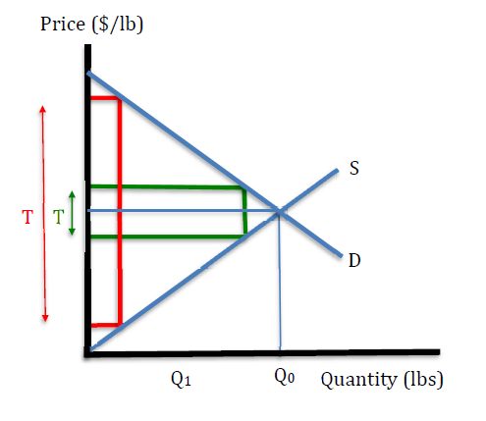
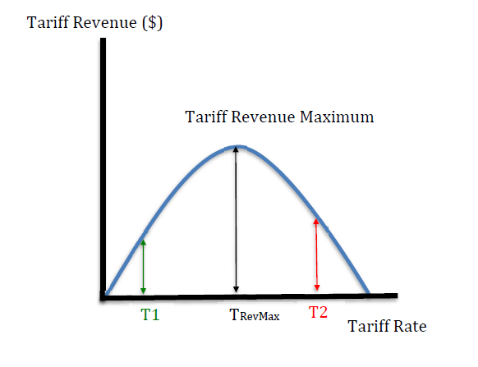
Tax Revenue Effects

Slide 18
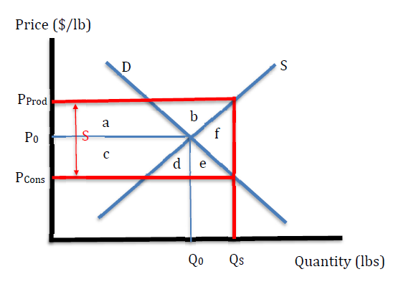
Price and Quantity Effects of a Subsidy
Suppose a specific subsidy of S ($/lb) is imposed on in a market
In diagram
S = P_{Prod} - P_{Cons}
S(P_{Prod}) = D(P_{Cons})
Consumer price falls with subs
Producer price rises with subs
Quantity traded rises with subs

Slide 19
Welfare Effects of a Subsidy
Change in Welfare from Subs.
ΔCS = + c + d + e
ΔPS = + a + b
Subs Revenue Effect
= - (a + b + c + d + e + f)
ΔMW = - f
f is a deadweight/efficiency loss

Slide 20
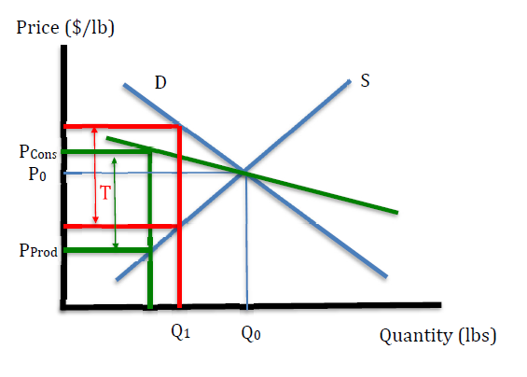
Tax Incidence
Tax incidence refers to who pays more of the tax
Because P_{Cons} rises, consumers pay a part of the tax
Because P_{Prod} falls, producers pay part of the tax
Note how consumers pay less as demand becomes more elastic (flatter), c.p.

Slide 21
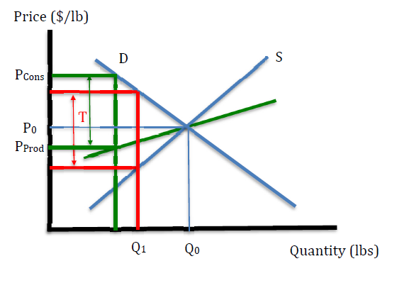
Tax Incidence
Note how producers pay less as supply becomes more elastic (flatter), c.p.
→ the more sensitive you are to price changes, the lower the tax incidence

Slide 22
Tax Problem
Suppose
Q_{D} = 40 - P
Q_{S} = P
Tax: T = $6 per lb
Solve for P_{Cons}, P_{Prod}, and Q
Solve for DWL due to the tax

Slide 23
Subsidy Problem
Suppose
Q_{D} = 40 - P
Q_{S} = P
Subsidy: S = $4 per lb
Solve for P_{Cons}, P_{Prod}, and Q
Solve for DWL due to the subsidy

