Slide 1
Theory of Market Supply
Steven Suranovic
George Washington University

Slide 2
Theory of Supply
Mechanics of the supply function
Shifts vs movements along the curve
Derived from the assumptions of perfect competition
Many firms taking prices as given because they are each too small to affect the market price
Homogeneous good, perfect info, no deception, profit-max firms, standard cost functions
No supply function in monopoly or oligopoly
Because these firms don’t take market price as given; they set the market price

Slide 3
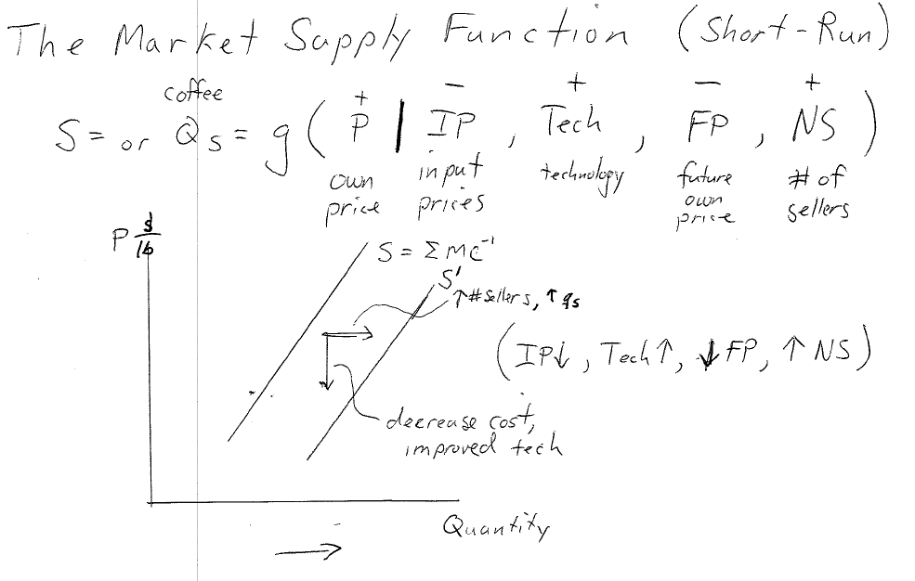
The Market Supply Function – Short-Run

Slide 4
A Supply Function
General Function
Specific Linear Function
Ceteris Paribus (Everything else constant) ‐ Let
IP = 10
Let the “5” incorporate everything else.
Then Q_{S} = +P ‐ (1/2)*10 + 5 = P – 5 + 5 = P + 0
Q_{S} = P

Slide 5
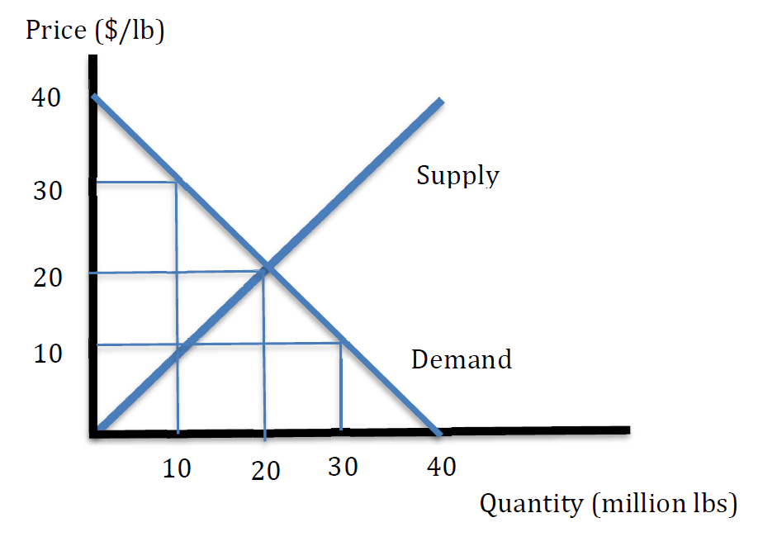
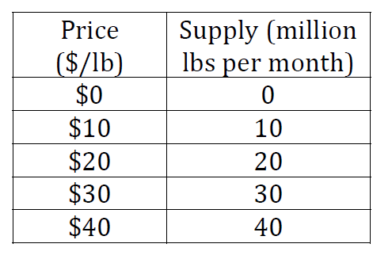
A Supply Function
Using this supply function: Q_{S} = P
Create a Supply Schedule
Recall: Q_{D} = 40 - P

Slide 6
Shifting the Supply Function
Suppose Other determinants change (5 ‐> 10) –
e.g. Tech increases; or # of firms rises
ceteris paribus (IP remains fixed at 10)
New Supply Function: Q_{S} = +P – (1/2)IP + 10
Q_{S} = P + 5

Slide 7
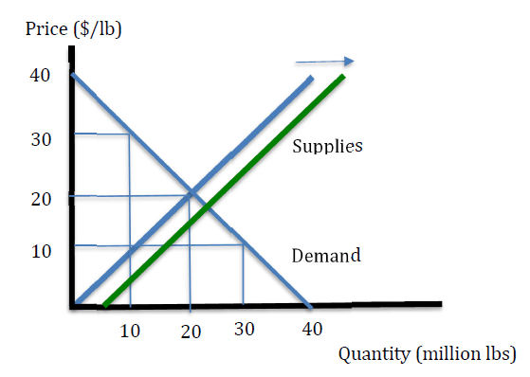
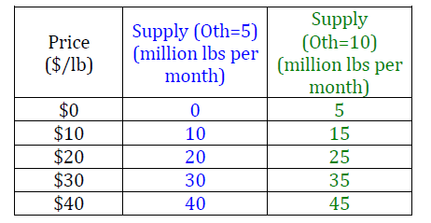
Shifting the Supply Function
Using this supply function: Q_{S} = P + 5
Create a Supply Schedule
Supply shifts right

Slide 8
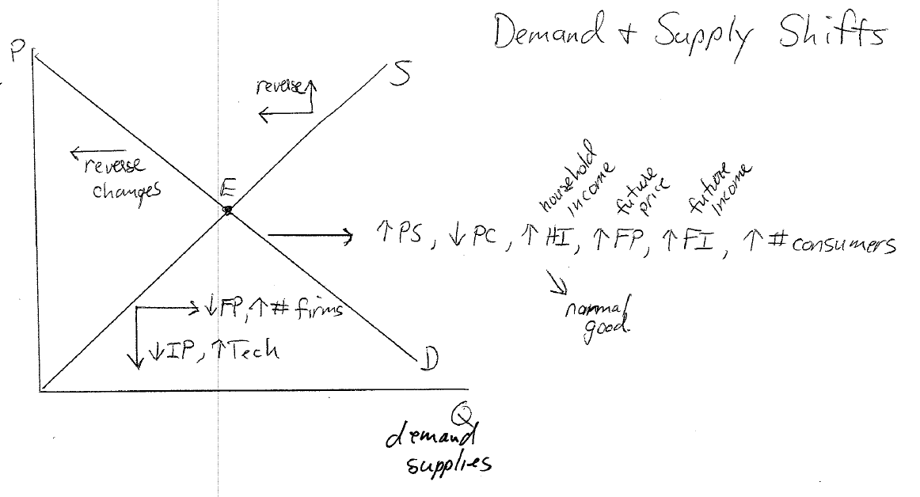

Slide 9
Market Equilibrium
A market equilibrium is the particular price and quantity traded that the market will settle towards
The profit-max and utility-max behavior is what causes the tendency to move to an equilibrium
“Equilibrium stories” explain the adjustment process to an equilibrium
There are two versions:
1) what if the price is too low
2) what if the price is too high

Slide 10
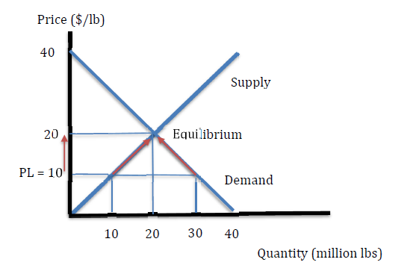
Equilibrium Story: Price too Low
Suppose the price P = PL = 10
@PL Q_{D} = 40 – 10 = 30
@PL Q_{S} = 10
Excess demand = 30 – 10 = 20
➔ Auctioneer raises price because desires to trade are not equal .. Too much demand. Inventories fall.
As price rises, demand falls and supply rises until P = 20

Slide 11
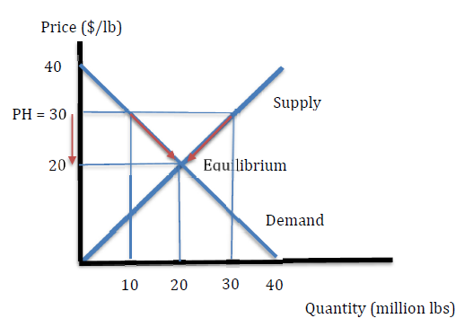
Equilibrium Story: Price too High
Suppose the price P = PL = 30
@PL Q_{D} = 40 – 30 = 10
@PL Q_{S} = 30
Excess supply = 30 – 10 = 20
➔ Auctioneer lowers price because desires to trade are not equal .. Too much supply and buildup of inventory
As price falls, demand rises and supply falls until P = 20

Slide 12
