Slide 1
Principles of Microeconomics with Ethics
Prof. Steve Suranovic
George Washington University

Slide 2
Course Features
Microeconomics
Study of individual households and firms
Study of market structures
Study of government policies
Macroeconomics
Study of economic aggregated variables (GDP, inflation, etc)

Slide 3
Course Features
Uniqueness of this Course
Relevance of Ethics and Economics
Focus on Economic Method (model building)
Presentation of less complex to more complex markets
Focus on market failures
Focus on government failures
Moderate ideology

Slide 4
Because I’m Happy
https://www.youtube.com/watch?v=y6Sxv-sUYtM

Slide 5
The Goal of Economics
Economics is
the study of how to promote happiness
through the production, consumption and distribution
of goods and services.
What is Happiness?
How is it measured?
Also, well-being, welfare, satisfaction, utility, surplus value, etc.

Slide 6
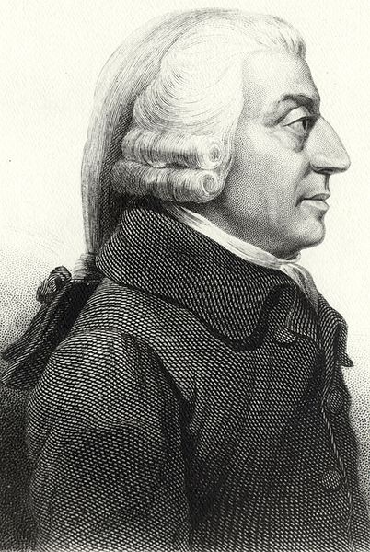
Adam Smith (1723 – 1790)
Founder of Modern Economics
The Wealth of Nations (1776)
The Theory of Moral Sentiments (1759)

Slide 7
Four Important Economic Principles
The Profit Motive and Self Interest
The Division of Labor
Mutually Voluntary Exchange
The Invisible Hand

Slide 8
The Profit Motive
“It is not from the benevolence of the butcher, the brewer, or the baker, that we expect our dinner, but from their regard to their own interest. We address ourselves, not to their humanity but to their self-love, and never talk to them of our own necessities but of their advantages.”
(Smith WoN, : B.I, Ch.2)

Slide 9
Self-interest Exception?
Buddhist Monks in Thailand
https://www.youtube.com/watch?v=HN-f-2uG-kI

Slide 10
Self-Interest Exception?

Slide 11
The Profit Motive Controversy
Is Greed Good?
Gordon Gekko “Wall Street” (1987)
http://www.youtube.com/watch?v=R8y6DJAeolo

Slide 12
The Profit Motive Controversy

Slide 13
The Profit Motive Controversy
Is Greed Good?
Gordon Gekko “Wall Street: Money Never Sleeps” (2010)
https://youtu.be/PgGPLidFZ60?t=40
(:40 – 1:50)

Slide 14
The Profit Motive Controversy

Slide 15
The Division of Labor
“Adam Smith, Wealth of Nations, Chapter 1 - …. (consider) the trade of the pin-maker; a workman not educated to this business … could scarce, perhaps, with his utmost industry, make one pin in a day, and certainly could not make twenty. But in the way in which this business is now carried on, not only the whole work is a peculiar trade, but it is divided into a number of branches, of which the greater part are likewise peculiar trades. One man draws out the wire, another straights it, a third cuts it, a fourth points it, a fifth grinds it at the top for receiving the head; to make the head requires two or three distinct operations; to put it on is a peculiar business, to whiten the pins is another; it is even a trade by itself to put them into the paper; and the important business of making a pin is, in this manner, divided into about eighteen distinct operations, …. I have seen a small manufactory of this kind where ten men only were employed, and where … they could, when they exerted themselves, make among them about twelve pounds (or about four thousand eight hundred) pins in a day. … But if they had all wrought separately and independently, and without any of them having been educated to this peculiar business, they certainly could not each of them have made twenty, perhaps not one pin in a day;

Slide 16
The Toaster Project
Thomas Thwaites attempts to make a simple toaster on his own
Toaster Project (Watch especially 0-2:10; and 9:00- 10:08)

Slide 17
The Division of Labor
In production, Labor is “divided” into separate tasks
The result is a significant increase in productivity – namely the quantity of output per worker rises
Today worker specialization is high
Accountants, computer programmers, financial analyst, nurse, nurse practitioner, physician’s assistant, etc. etc.
Contributes to the Wealth of the a Nation

Slide 18
Mutually Voluntary Exchange
“Nobody ever saw a dog make a fair and deliberate exchange of one bone for another with another dog. Nobody ever saw one animal by its gestures and natural cries signify to another, this is mine, that yours; I am willing to give this for that. When an animal wants to obtain something either of a man or of another animal, it has no other means of persuasion but to gain the favour of those whose service it requires.”
(Smith WoN, : B.I, Ch.2,)

Slide 19
Mutually Voluntary Exchange
Exchange, or Trade, is a uniquely human activity
Exchange is the key feature of an economy
This is why we will begin by studying this feature.

Slide 20
The Invisible Hand
“THIS division of labour, from which so many advantages are derived, is not originally the effect of any human wisdom, which foresees and intends that general opulence to which it gives occasion. It is the necessary, though very slow and gradual consequence of a certain propensity in human nature which has in view no such extensive utility; the propensity to truck, barter, and exchange one thing for another.”
Smith – WoN, 1776. Book I, Chapter 2

Slide 21
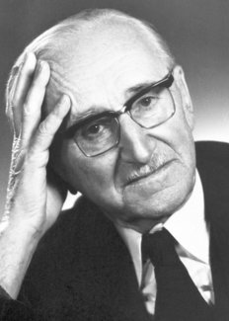
Friedrich Hayek (1899 – 1992)
Nobel Prize winner 1974
Highlights the “spontaneous economic order”
Emphasized the role of prices in transmitting economic information
Strong proponent of free markets
The Road to Serfdom (1944)

Slide 22
I, Pencil
Leonard Read published this article in 1958
It asserts that no one person knows how to make a pencil
It shows
Cooperation without coercion
Adam Smith’s invisible hand
Role of the price system to communicate information
Freidrich Hayek’s spontaneous economic order
General Equilibrium interconnections
I, Pencil – The Movie

Slide 23
I, Pencil The Movie

Slide 24
The Invisible Hand Controversy
Joseph Stiglitz - Invisible hand is invisible because it’s not there
http://www.youtube.com/watch?v=9qjvwQrZmpk

Slide 25
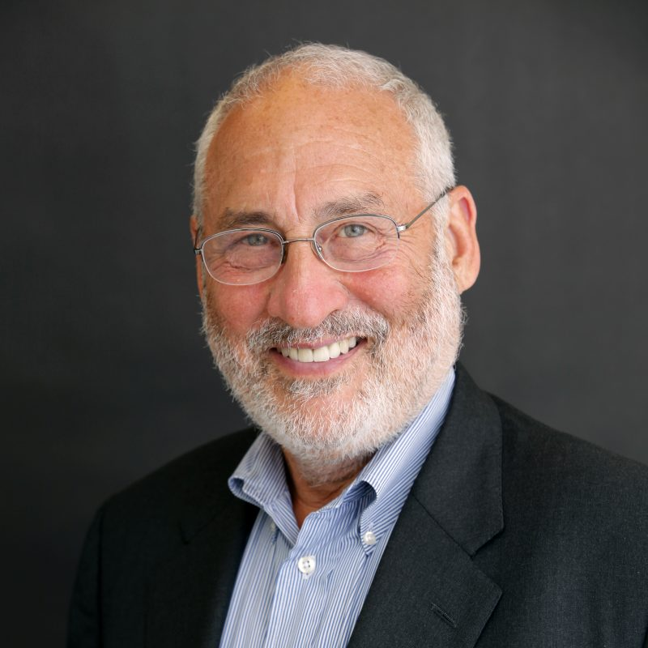
Joseph Stiglitz (1943- )
Nobel Prize winner 2001
Columbia University
Work focuses on market imperfections especially imperfect information
Critical of “laissez-faire” economics
“Globalization and its Discontents” (2002)

Slide 26
The Invisible Hand Controversy

Slide 27
The Invisible Hand Controversy
Milton Friedman - The Invisible hand works
http://www.youtube.com/watch?v=DrZGT89ht-g

Slide 28
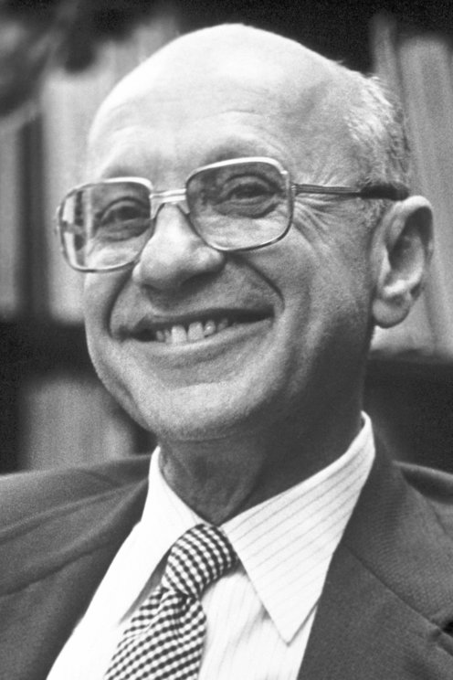
Milton Friedman (1912-2006)
Nobel Prize winner 1976
Chicago School
Known for promoting maximization of shareholder value and “laissez-faire”
Is a lightning rod for criticism from left (incl. from Stiglitz)
“Capitalism and Freedom (1962)
“Free to Choose” (1980)

Slide 29
The Invisible Hand Controversy

Slide 30
The Invisible Hand Controversy
Who’s right? Stiglitz or Friedman?
By the end of the course, I will demonstrate that both of them are right.
This course will show how the economy works .. But also
Conditions under which the economy works well (Friedman)
Conditions under which the economy works poorly (Stiglitz)

Slide 31
The Economic System Controversy Capitalism vs Socialism
Capitalism
Private ownership of capital (the means of production)
Often w/ limited government intervention
Socialism
State ownership of capital/businesses
Centrally-planned economies
Also, social democracies (Scandinavia)
Also … Fascism
Pvt ownership w/ heavy government control
Often w/ strong nationalism

Slide 32
Economics Controversies
Below are optional articles with reactions to some famous economists
Milton Friedman Was Wrong
Paul Samuelson vs Milton Friedman
Friedrich Hayek: Not Exactly the Libertarian Darling He’s Claimed As
Milton Friedman and Friedrich Hayek: Fifty Years Later
An Open Letter to Joseph Stiglitz, by Kenneth Rogoff
Nobel Winner Patiently Shows Adam Smith Wrong

